Slide 1
Reading LDCT
Lung Cancer Screening Basics

Slide 2
Objectives
How did we get here?
Discuss who gets screened
Low dose protocol
Reading the study
Assigning a Lung RADs Category
Troubleshooting

Slide 3
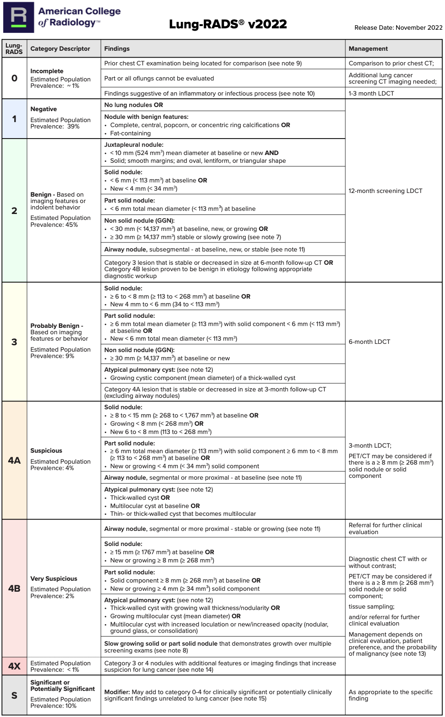
LUNG RADS

Slide 4
History of Lung Cancer Screening
Lung Cancer is leading cause of cancer mortality in the US and Worldwide
In 2023 there were 230,000 new cases with 127,000 deaths (21% of all cancer-related deaths)
Majority of symptomatic individuals present with advanced stage disease
National Lung Screening and NELSON (Dutch-Belgian) Trials
Both demonstrated a decrease in mortality from lung cancer in screened individuals
Early stage disease >> easier to treat and potentially cure

Slide 5

Who is Eligible for Screening?
Greater than age 50
Greater than or equal to 20 pack year smoking history
Asymptomatic
Able to tolerate definitive treatment for lung cancer

Slide 6
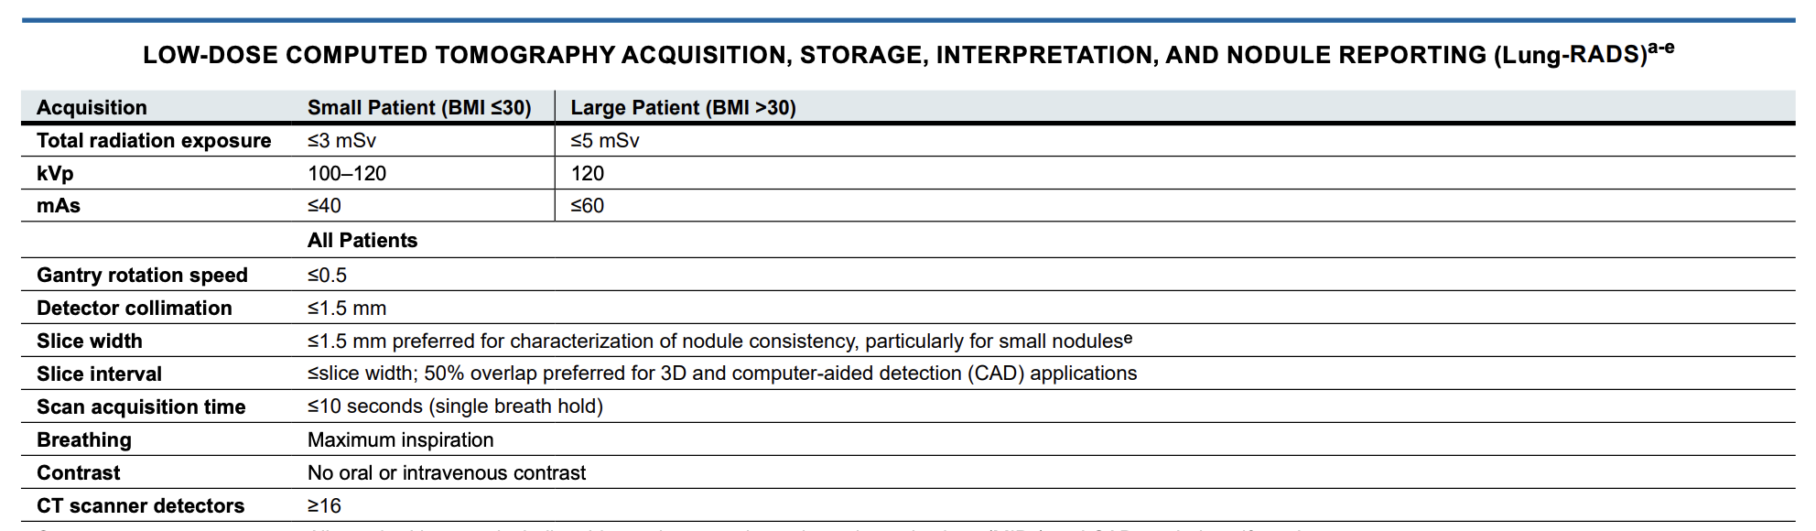
Low Dose Protocol

Slide 7
Reading LDCT
Thin series bone algorithm and soft tissue
Thick series soft tissue
Coronal and sagittal reformats
MIP series for improved nodule detection

Slide 8
Reading LDCT
Measuring nodules
  Measure on lung windows
  Measure long and short axis in same plane
  Measurements are averaged and reported to the nearest decimal point
  Reporting one dimension for round nodules is acceptable

Slide 9
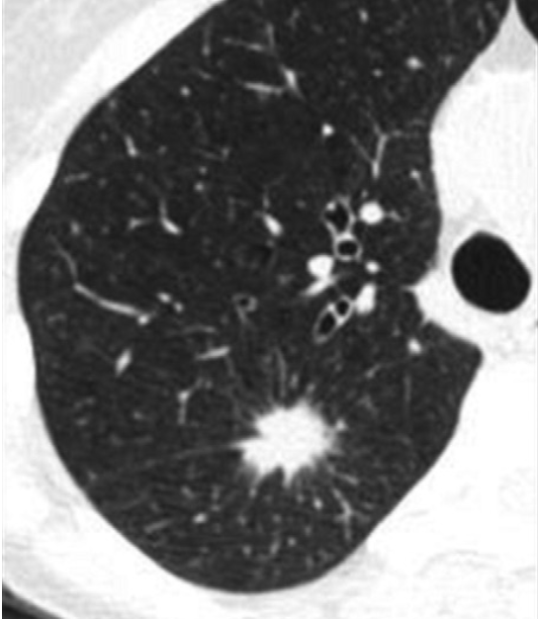
Reading LDCT
Solid nodules
Obscure underlying lung architecture, vessels, bronchi, septae etc.

Slide 10
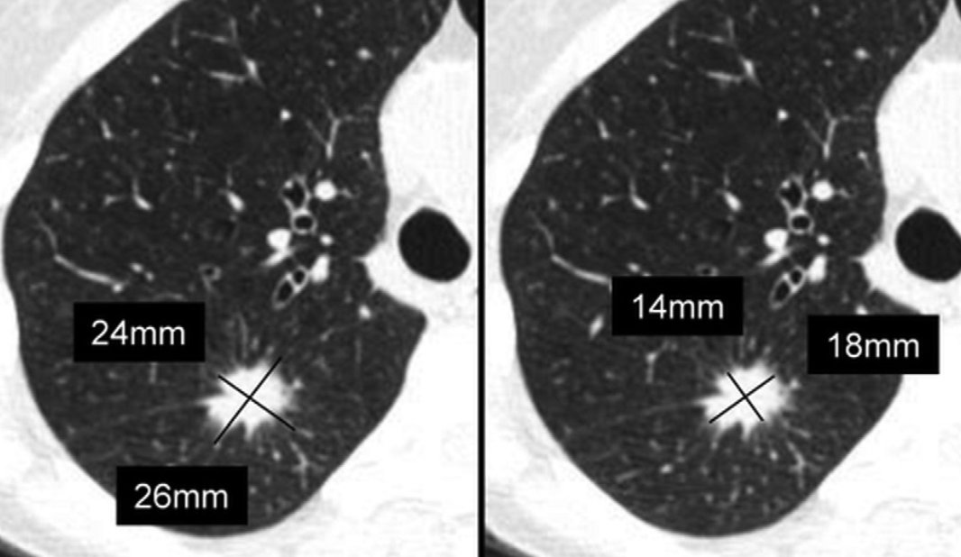
Reading LDCT

Slide 11
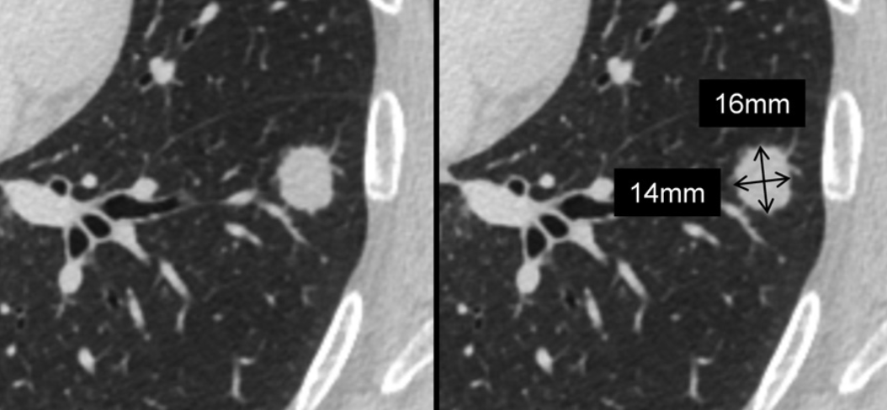
Reading LDCT

Slide 12
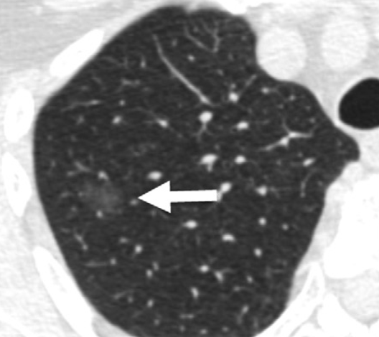
Reading LDCT
Ground glass nodules
  Do not obscure underlying structures

Slide 13
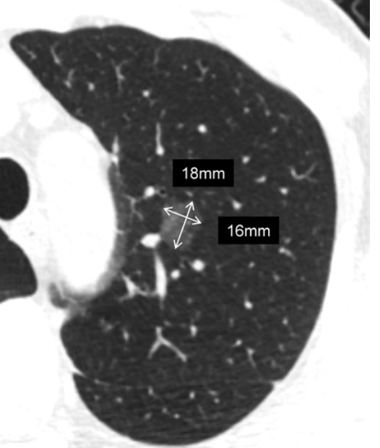
Reading LDCT

Slide 14
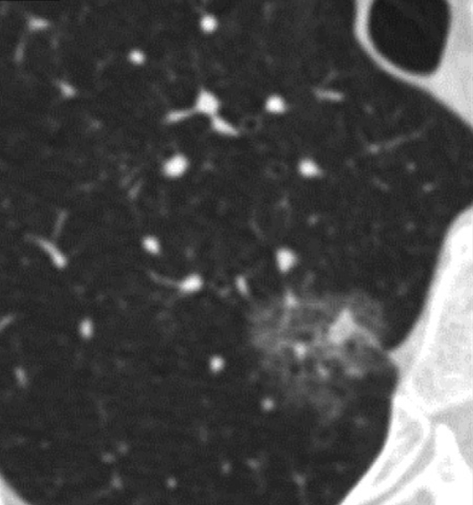
Reading LDCT
Subsolid or Part Solid Nodules
  Demonstrate both solid and ground glass components

Slide 15
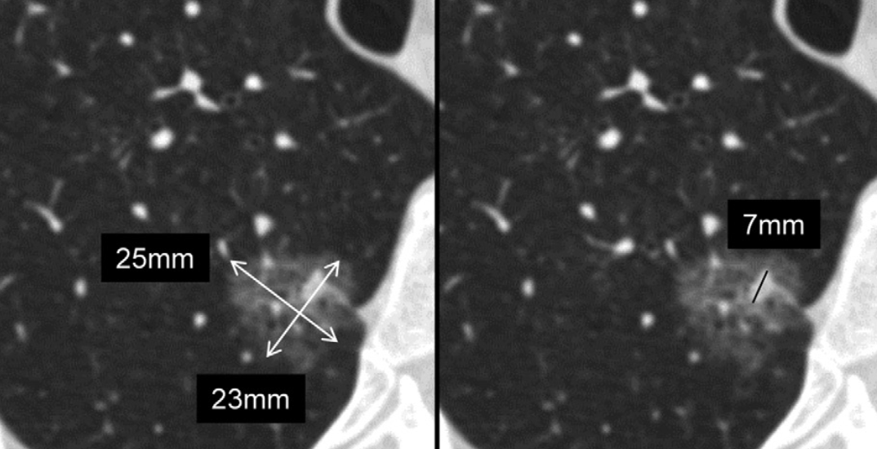
Reading LDCT

Slide 16
Reading LDCT
Atypical Pulmonary Cysts
  Up to 10% of lung cancers in high-risk patients may be associated with cystic precursors
  Cystic lung cancers are more likely to be missed at initial screening
  Thick-walled cysts
  Multilocular cysts
  Cysts with associated nodules

Slide 17
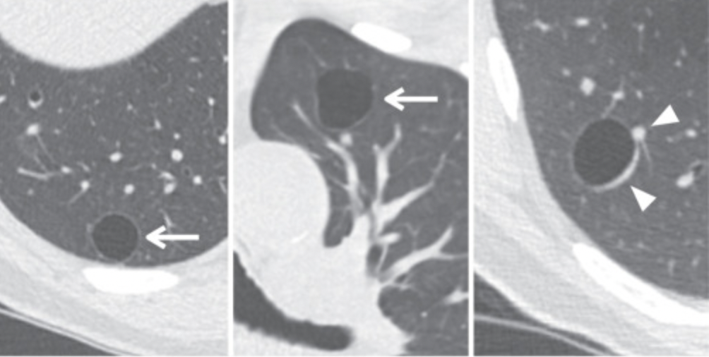
Reading LDCT
Thin-walled cysts
Not classified or managed according to Lung RADs

Slide 18
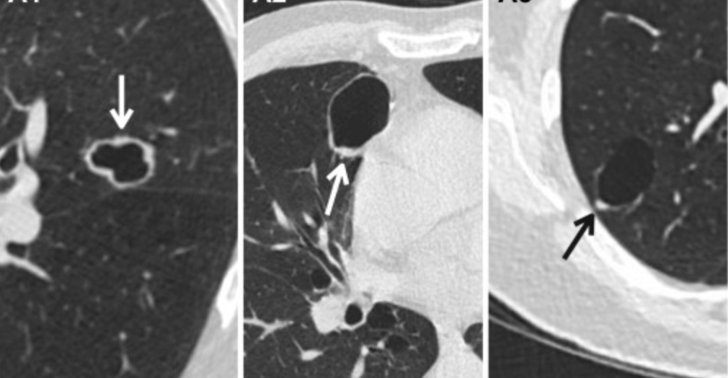
Reading LDCT
Thick-walled cysts
> 2mm thickness
Circumferential, asymmetric or focal types

Slide 19
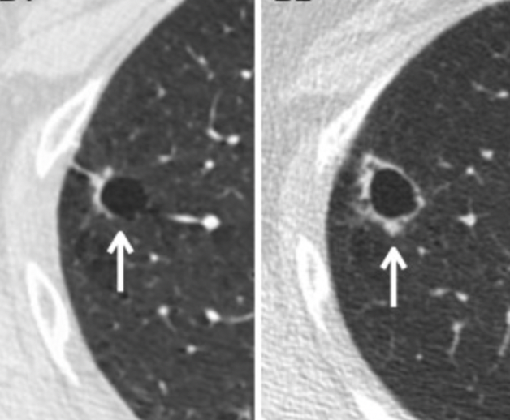
Reading LDCT
Thick-walled cysts with increasing wall thickness and nodularity
Category 4B

Slide 20
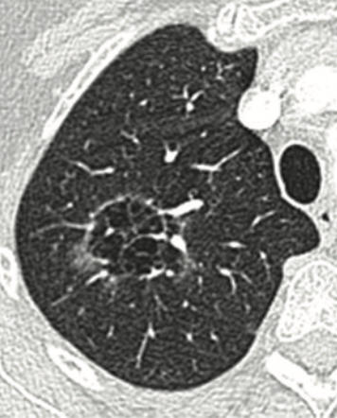
Reading LDCT
Multilocular atypical cyst

Slide 21
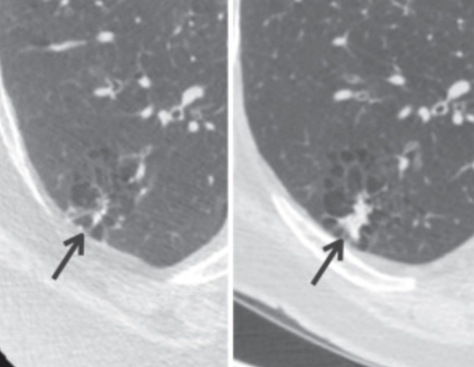
Reading LDCT
Growing solid component

Slide 22
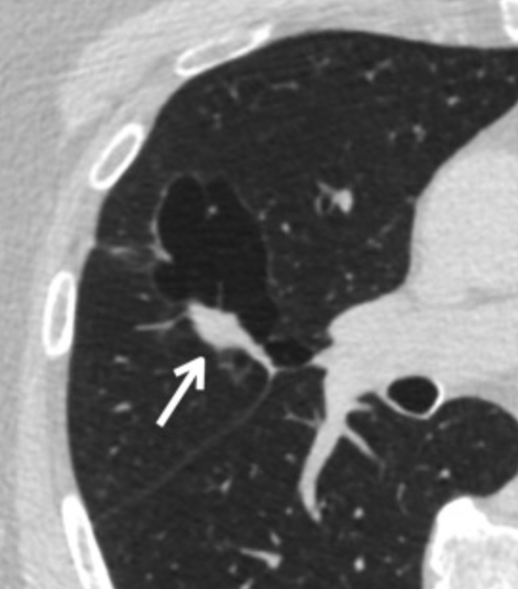
Reading LDCT
Cysts with associated nodules
Managed according to most suspicious feature

Slide 23
Reading LDCT
Endobronchial abnormalities
  Segmental or more proximal >> 4A >> 3-month LDCT
  Subsegmental or tubular >> favor infection >> 0 or 2
  Air within abnormality suggests secretions

Slide 24
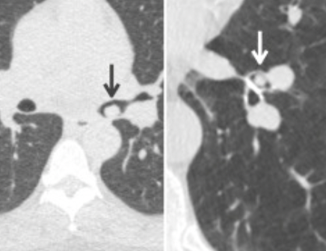
Reading LDCT
Proximal airway nodules

Slide 25
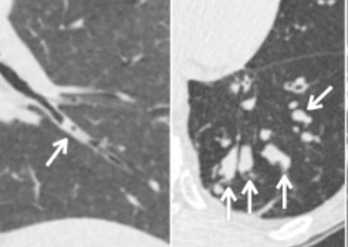
Reading LDCT
Tubular filling defects suggest infection

Slide 26
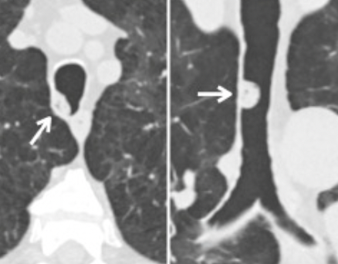
Reading LDCT
More central secretions

Slide 27
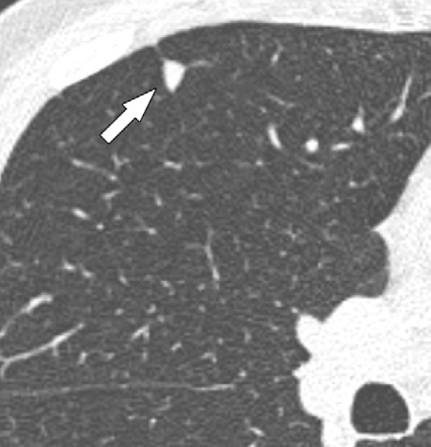
Reading LDCT
Perifissural/juxtapleural nodules
Ovoid or triangular nodules adjacent to pleura, mediastinum or diaphragm
Intrapulmonary lymph nodes
Cat 2 finding

Slide 28
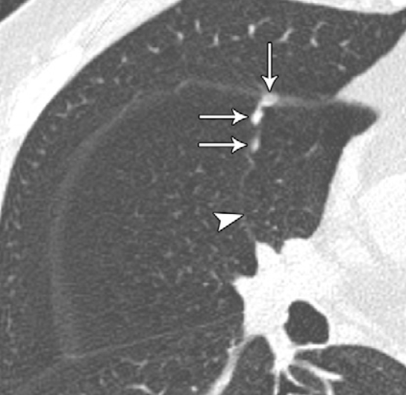
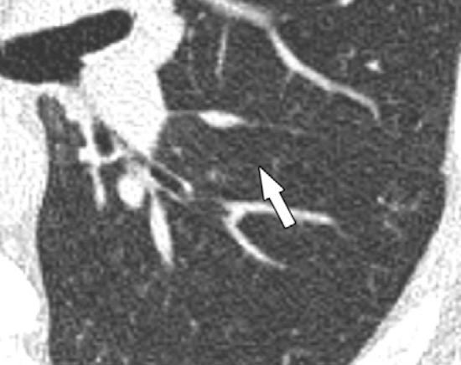
Reading LDCT

Slide 29
Lung RADs Categories

Slide 30
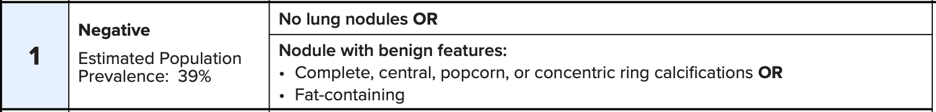
Lung RADs Categories

Slide 31
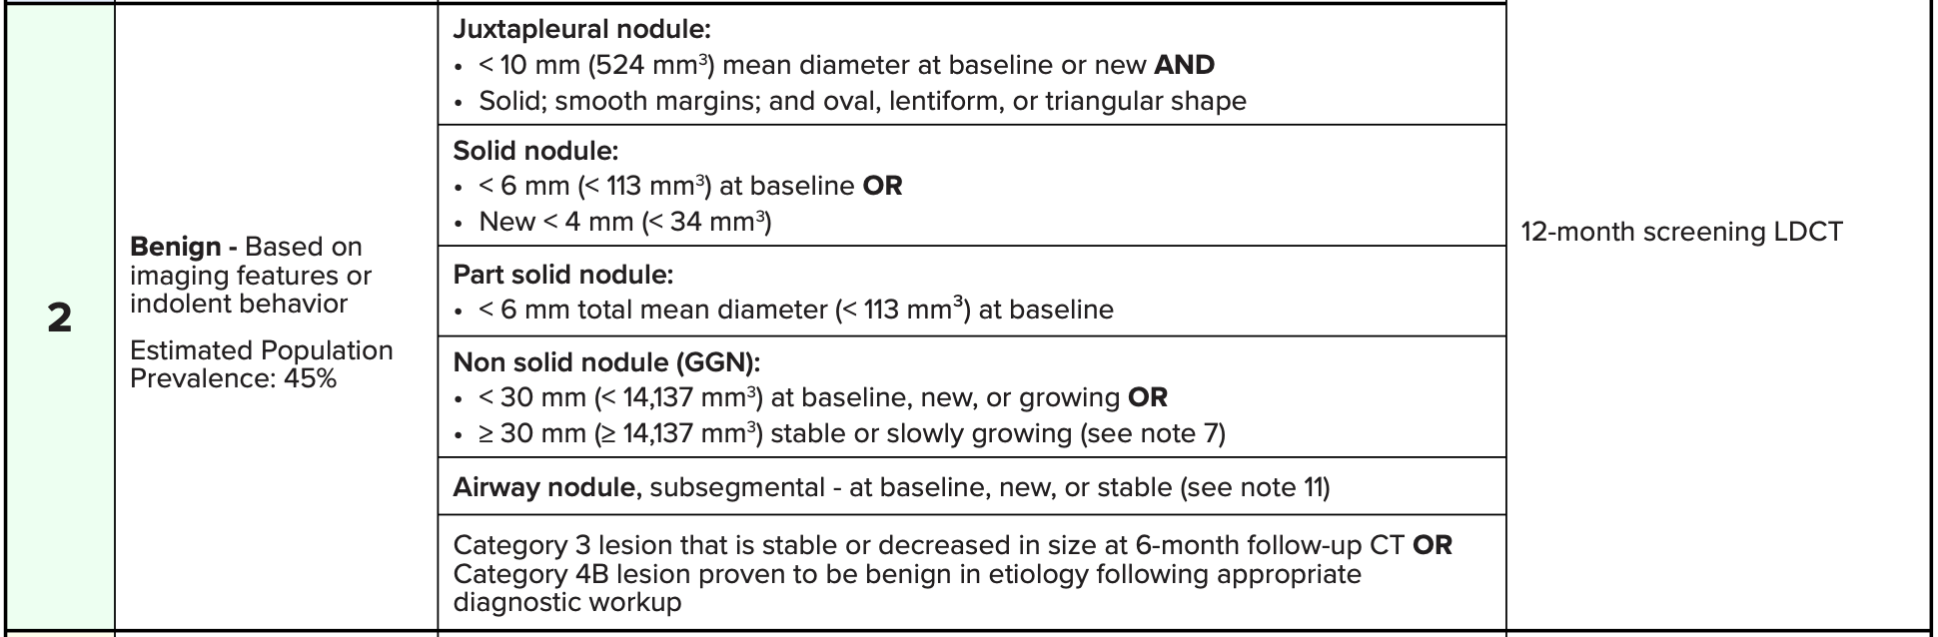
Lung RADs Categories

Slide 32
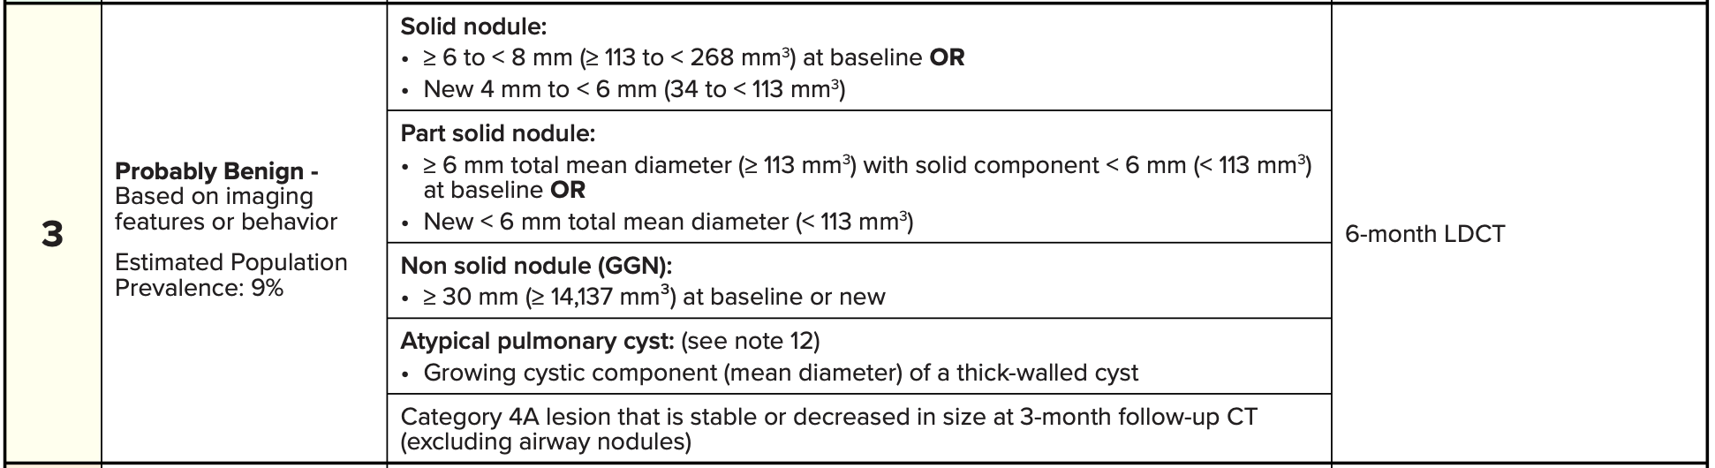
Lung RADs Categories

Slide 33
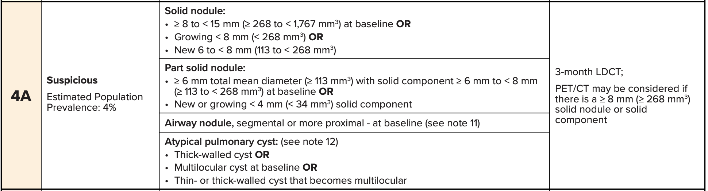
Lung RADs Categories

Slide 34
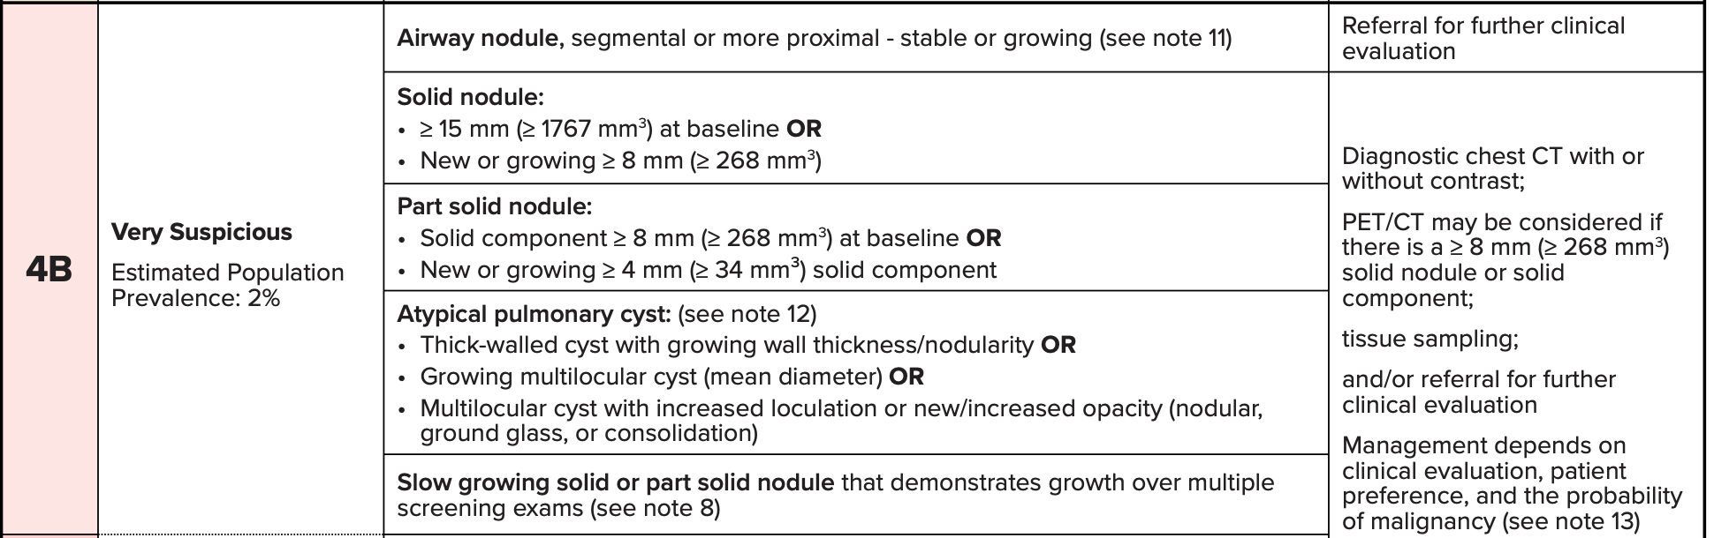
Lung RADs Categories

Slide 35
Lung RADs Categories

Slide 36
Lung RADs Categories

Slide 37
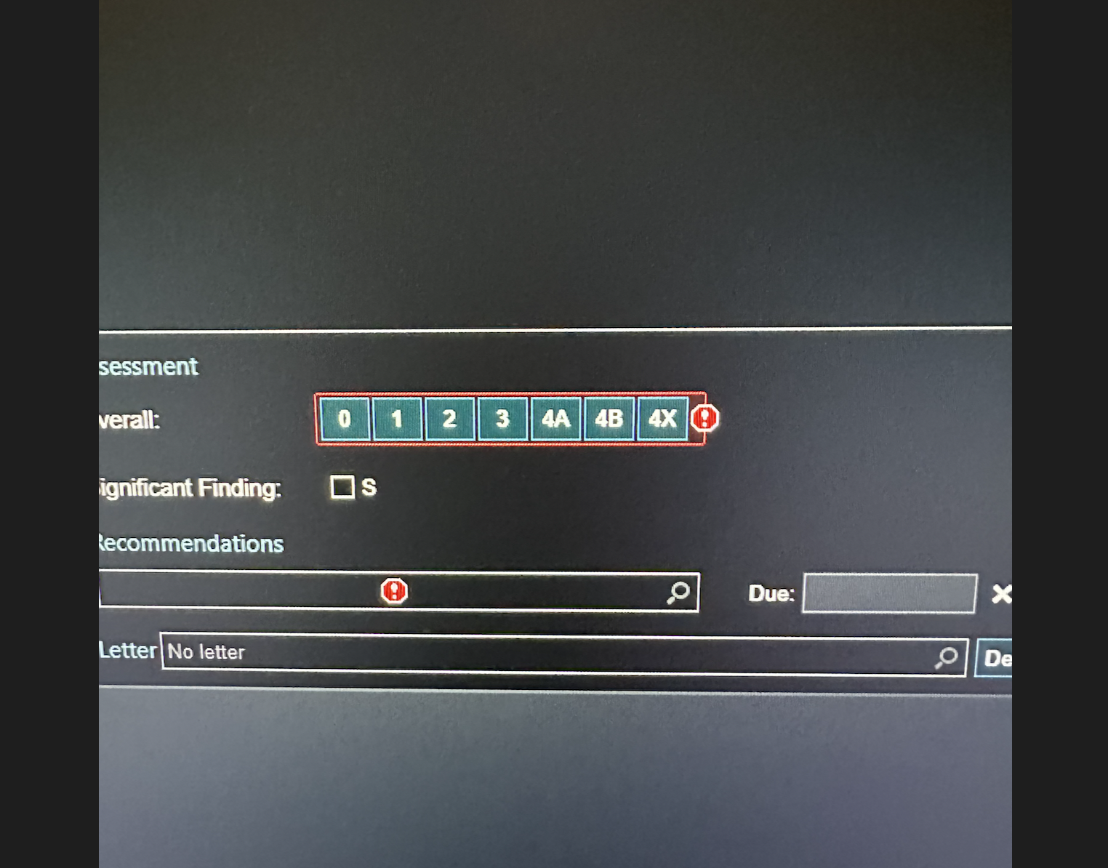
Reporting

Slide 38
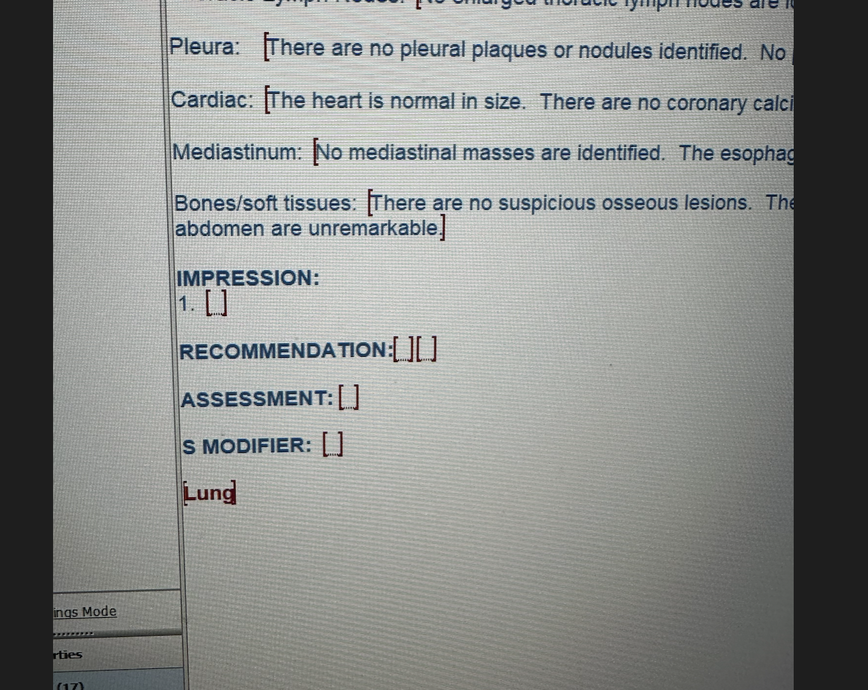
Reporting

Slide 39
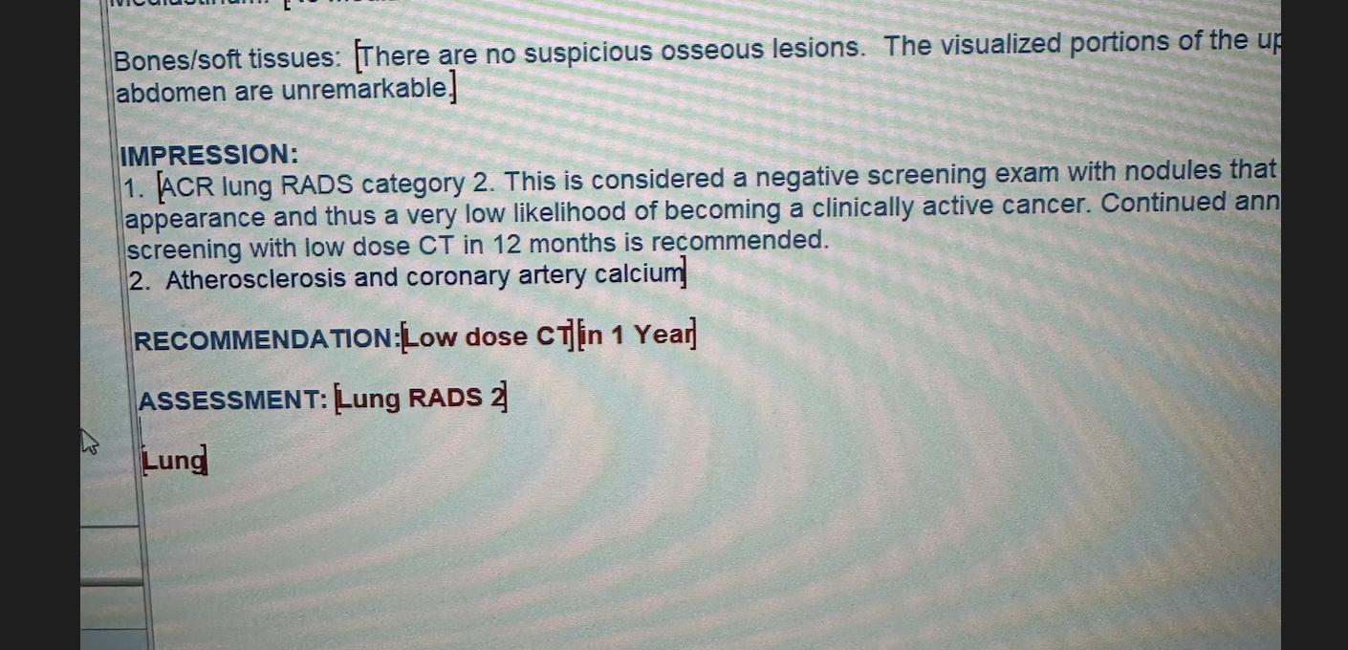
Reporting

Slide 40
Important Reporting Tidbits
Nodule growth defined as increase in mean diameter > 1.5 mm in 12- month period
Slow growing solid or part-solid nodules not meeting size threshold are suspicious and should be classified as 4B
Slow growing GGN should not be reclassified until they meet the size threshold for higher category
There is no “return to annual screening”. Follow-up studies should serve as new baseline.

