Slide 1
Importance of Imaging in Coronavirus Disease-19 (COVID-19)
Andrew Dyer, MD
Thoracic Imaging
Memphis Radiological PC
March 2020

Slide 2
Goals and Objectives
Discuss history of current coronavirus-19 (Covid-19) outbreak
Review imaging findings in Covid-19 infection
Review data from current outbreak with regards to laboratory and radiologic testing
Future considerations

Slide 3
Covid-19
Outbreak began in Wuhan, China during December 2019
Wuhan is the capital city of central China’s Hubei province
Novel coronavirus disease-19 likely has a zoonotic origin (bats?)
Believed to have originated from Huanan seafood market
7th known coronavirus to infect humans

Slide 4

Covid-19

Slide 5
Covid-19
Widespread human-to-human transmission has resulted in:
Over 70,000 cases worldwide
Over 1,800 deaths
2-3 % mortality
First US case reported on Jan. 20, 2020

Slide 6
Covid-19
Coronaviruses
  Among largest RNA viruses
  Transmitted from animals to humans
  Usually cause mild upper respiratory infections
  Common cold (~15%)
  Middle East Respiratory Syndrome (MERS)
  Severe Acute Respiratory Syndrome (SARS)

Slide 7
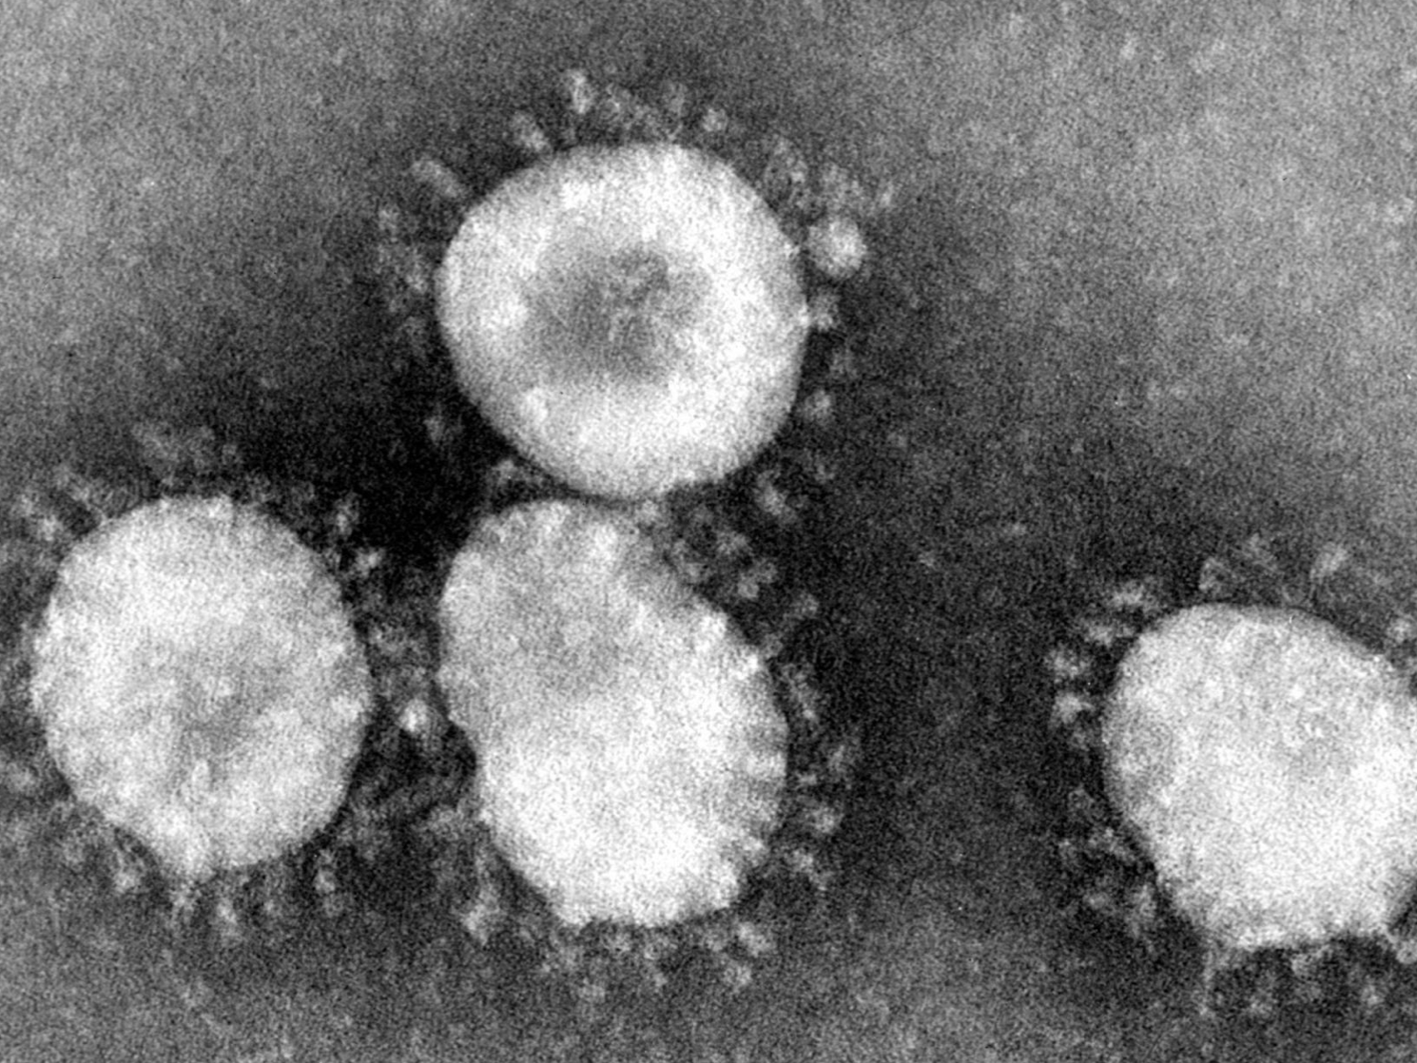
Coronavirus
Electron micrograph of coronavirus (avian infectious bronchitis virions). The surface “spike” proteins give the viral particles their characteristic halo from which their name is derived.

Slide 8
Covid-19
Common Symptoms
  Fever and cough
  Dyspnea
  Headache
  Muscle soreness
  fatigue

Slide 9
Covid-19
Approximately 20% of cases are considered severe
2-3% mortality rate
Severe disease often requires ICU admission with progression to acute respiratory distress syndrome (ARDS)

Slide 10
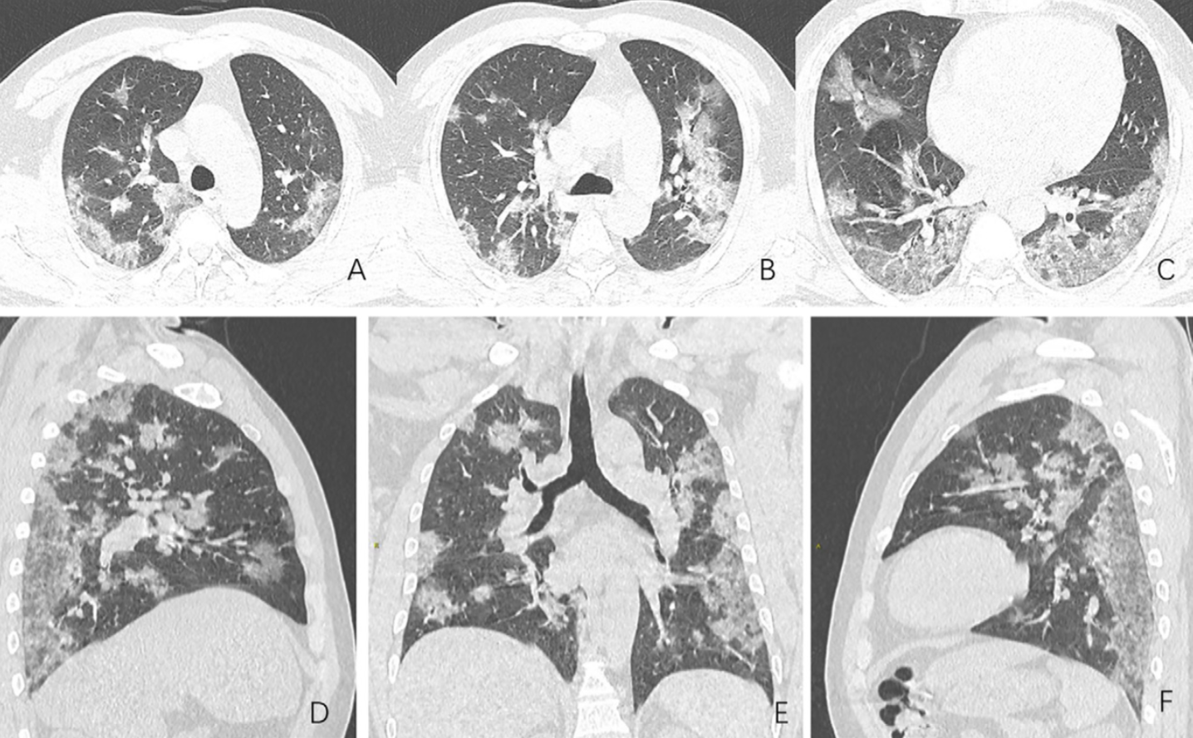
Covid-19
44 year old transportation employee presented with two weeks of high fever and cough. One of the earliest deaths at the epicenter of Covid-19 outbreak in Wuhan

Slide 11
Covid-19
Common Imaging Findings
  Peripheral, rounded GGO
  Crazy paving
  Subpleural opacities/bands
  Consolidation
Less common/late findings
  Organizing pneumonia patterns of reverse halo and peribronchovascular opacities
  cavitation

Slide 12
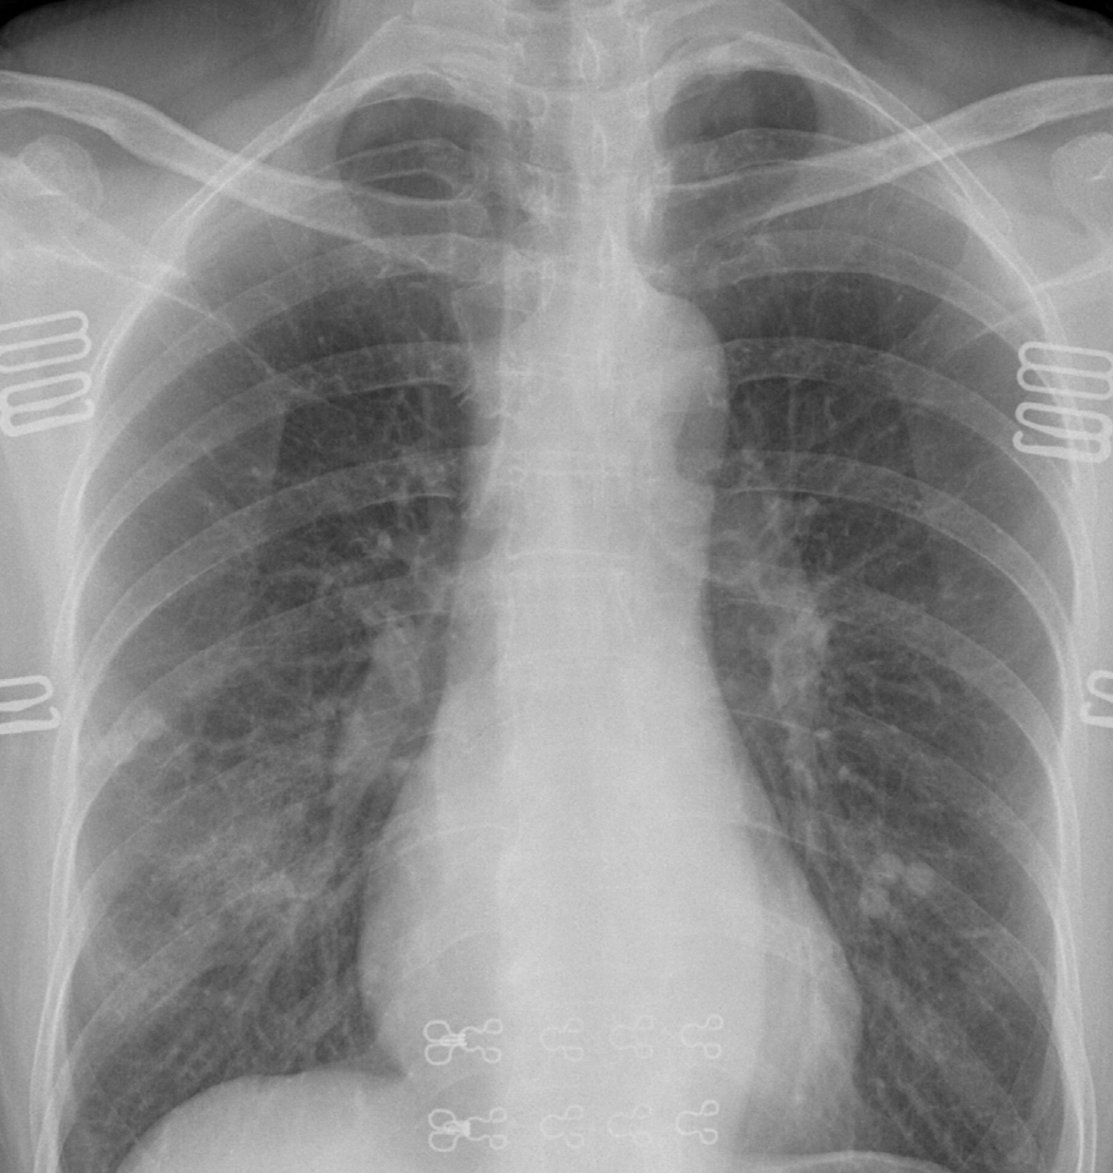
Covid-19
33 year old female patient with right infrahilar opacities

Slide 13
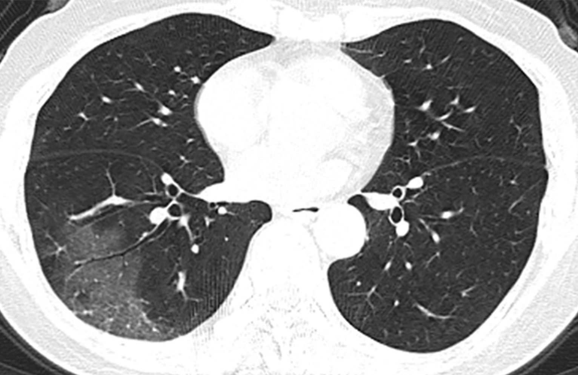
Covid-19
Same patient with peripheral GGO in the right lower lobe

Slide 14
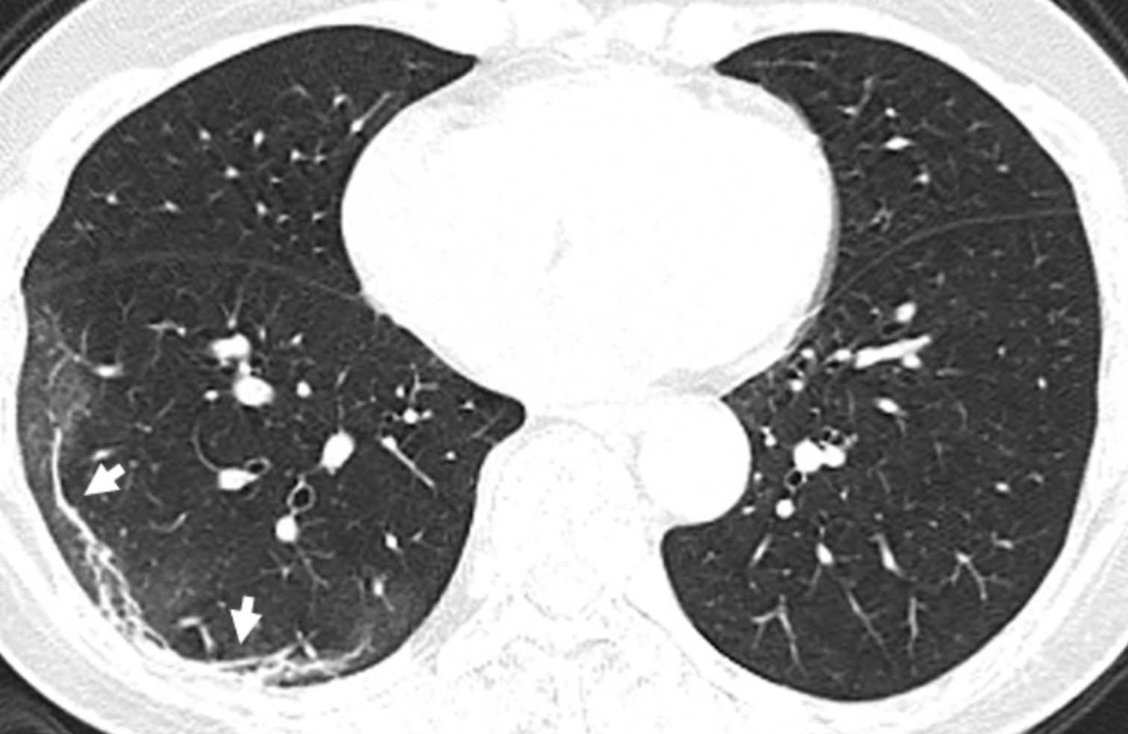
Covid-19
Follow up CT with clearing ground glass and developing subpleural bands

Slide 15
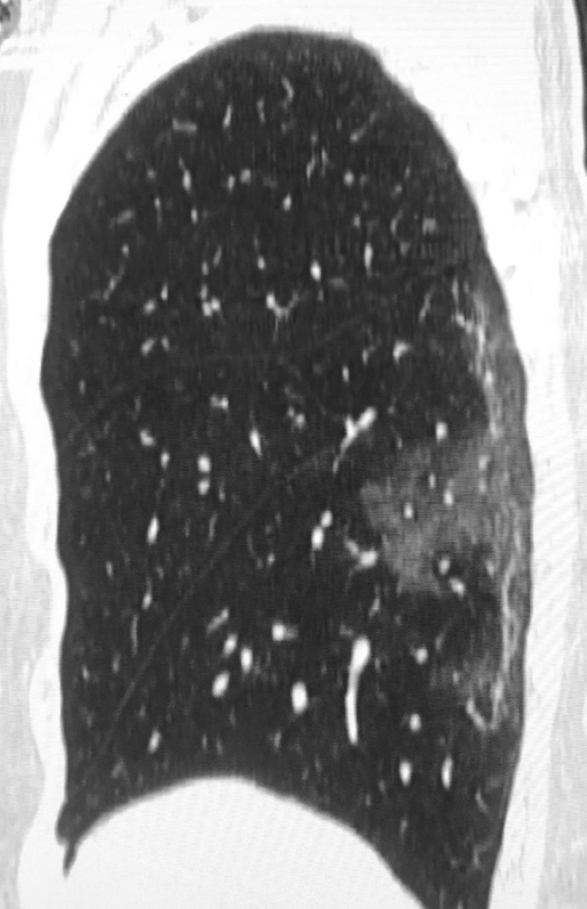
Covid-19
Sagittal reformatted images of same patient

Slide 16
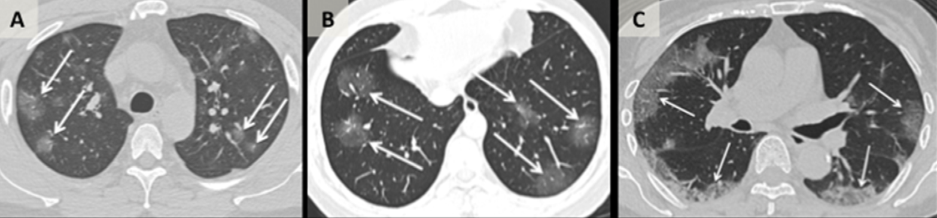
Covid-19

Slide 17
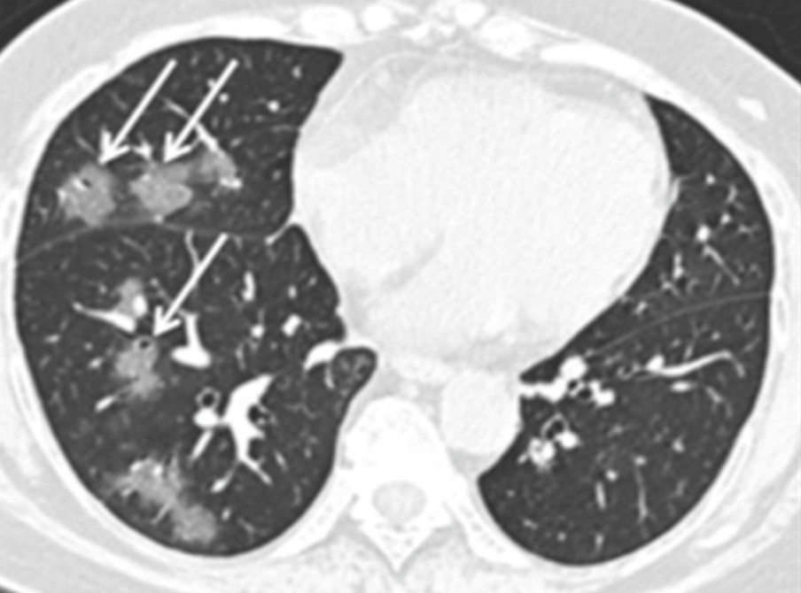
Covid-19

Slide 18
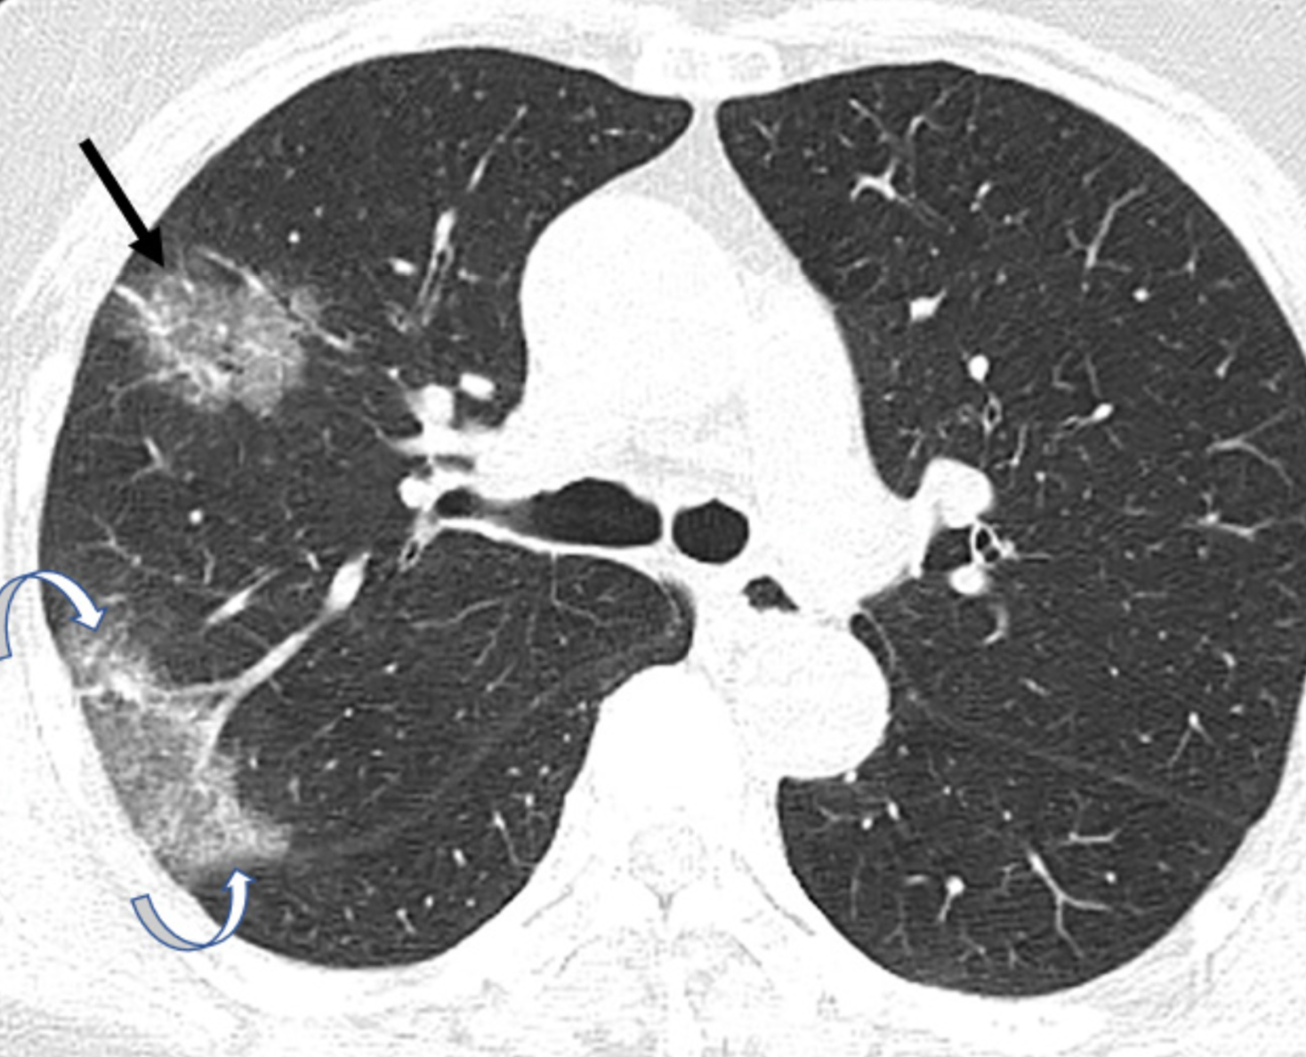
Covid-19
Late phase disease with organizing pneumonia pattern (reverse halo)

Slide 19
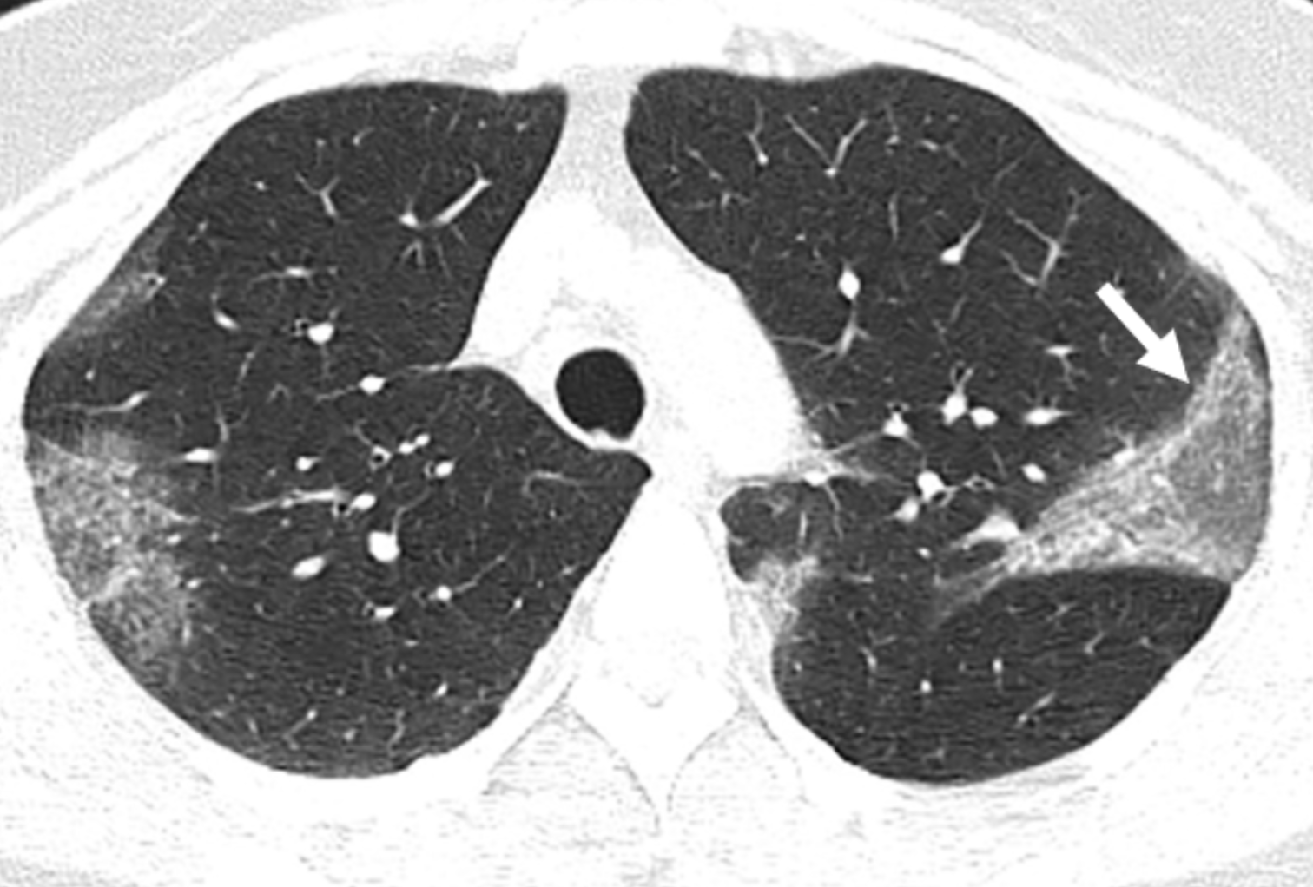
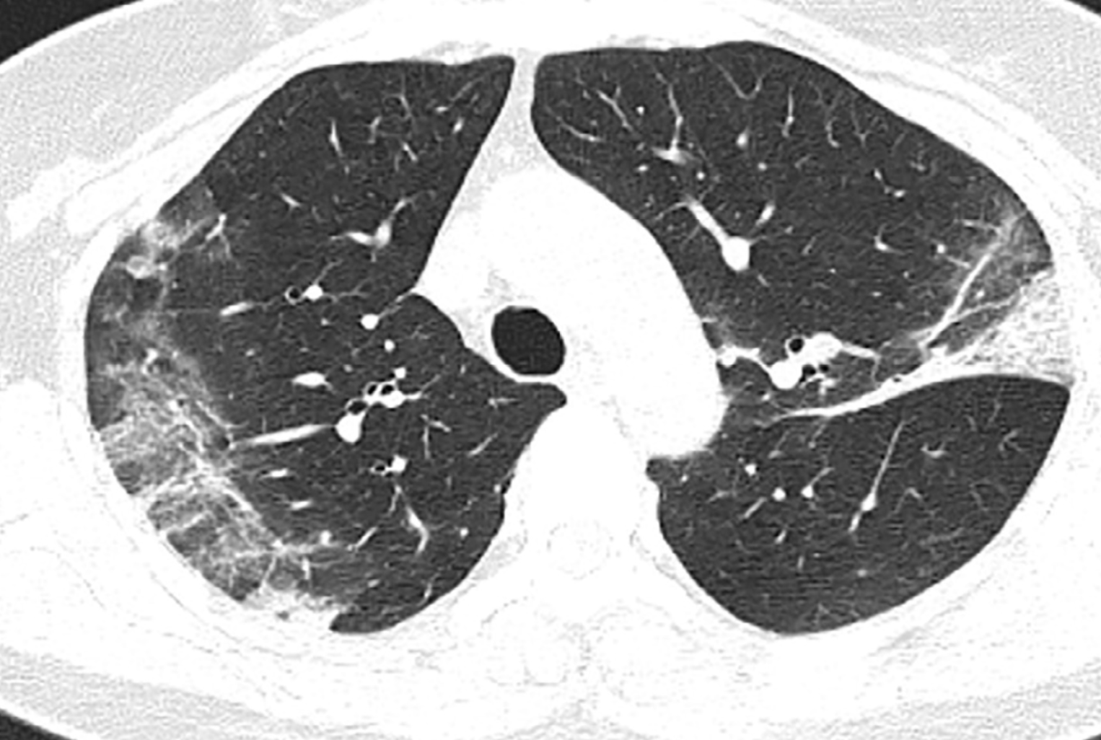
Covid-19

Slide 20
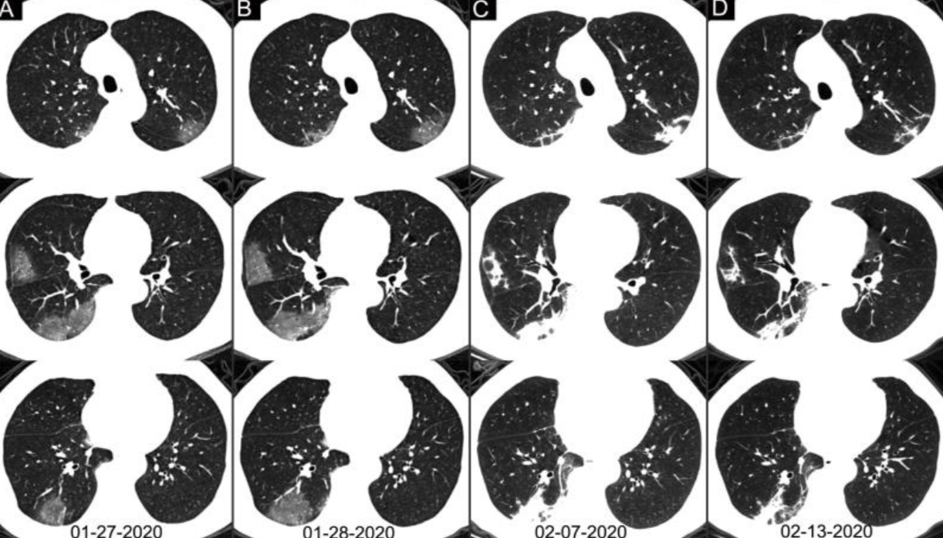
Covid-19

Slide 21
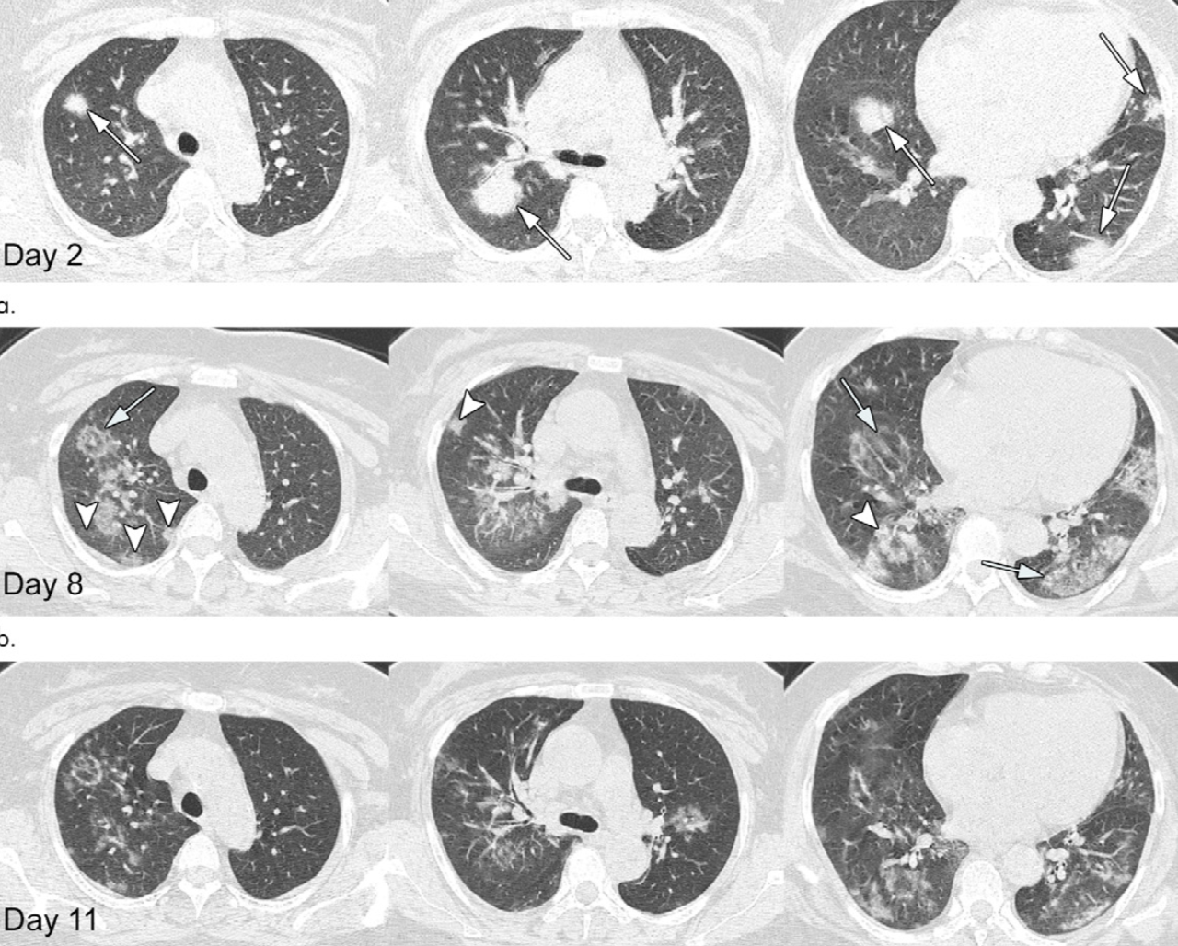
Covid-19

Slide 22
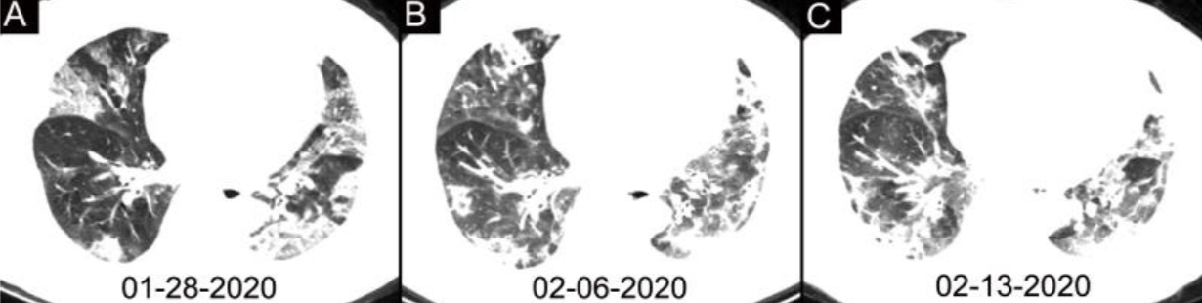
Covid-19

Slide 23
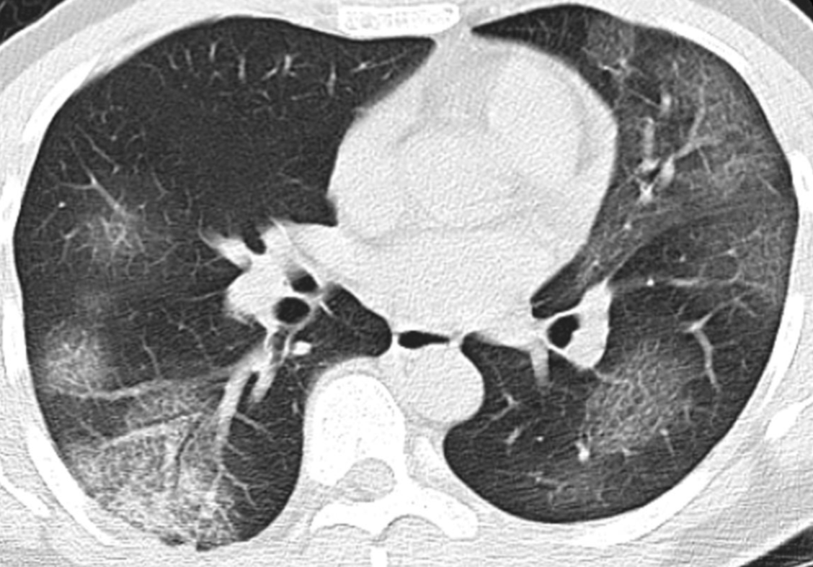
Severe Acute Respiratory Syndrome (SARS)
Patient with SARS imaged 5 days after onset of symptoms

Slide 24
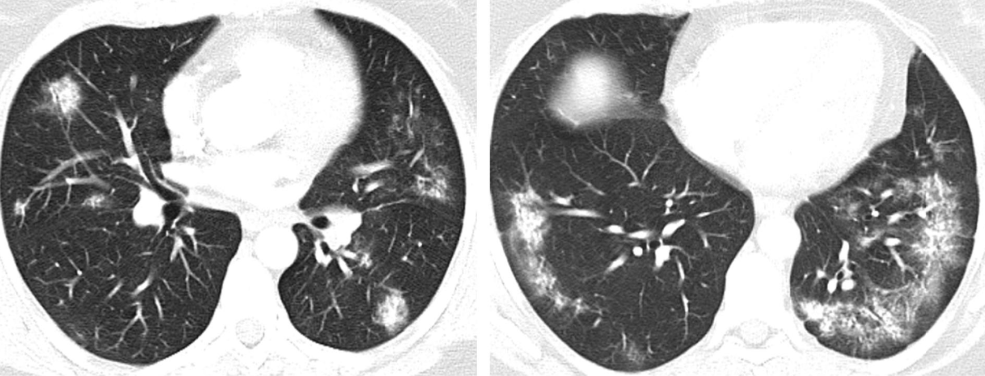
SARS
Late Phase imaging in SARS

Slide 25
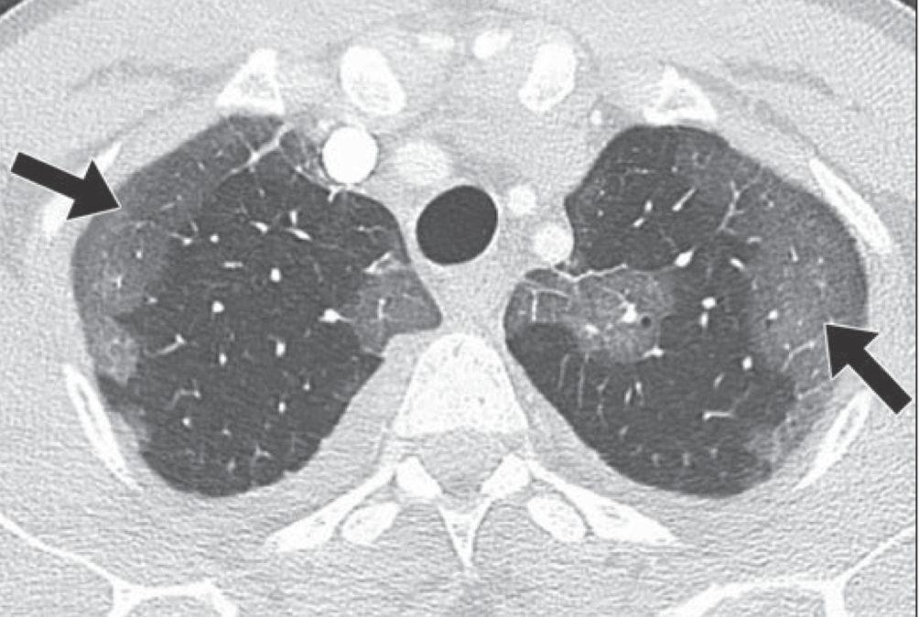
Middle Eastern Respiratory Syndrome (MERS)
Peripheral ground glass opacities in a patient with MERS. Images were obtained 9 days after onset of symptoms.

Slide 26
Covid-19
Most recent review in Radiology
  94 patients with positive PCR testing
  Separated imaging findings based on early (0-2 days), intermediate (3-5 days) and late (6-12 days) phases of the disease
  Calculated involved percentages of each lobe in the lungs
  “severity” scores ranged from 0-20

Slide 27
Covid-19
Imaging Findings of Covid-19
  This prospective analysis demonstrated bilateral opacities in 98% of patients
  CT findings were most pronounced approximately 10 days after onset of symptoms
  Lymphadenopathy, nodules and pleural effusions were notably absent in almost all patients

Slide 28
Covid-19
Patients imaged in the early phase were more likely to have normal CT (56%)
  Intermediate (9%)
  Late (4%)
Crazy paving, consolidation, bilateral lung involvement and linear opacities all increase in intermediate and late phases

Slide 29
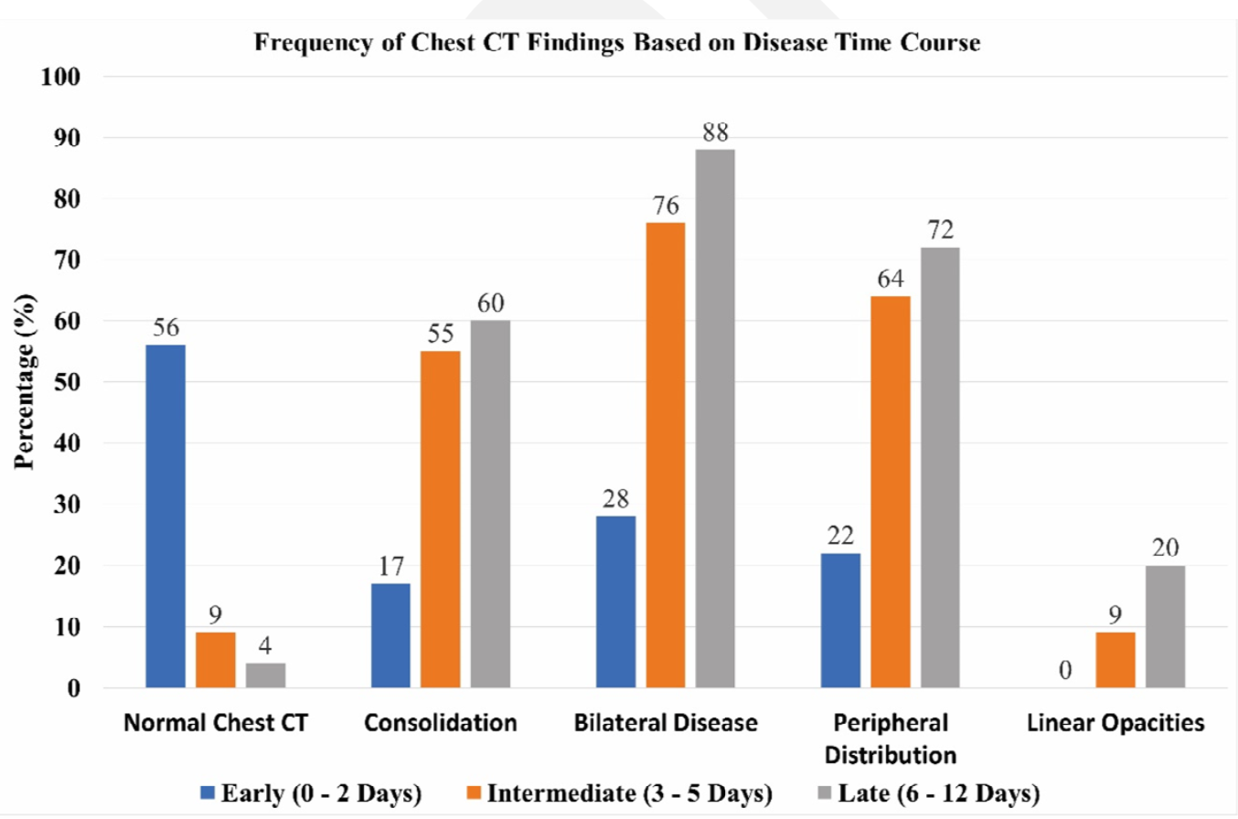
Covid-19

Slide 30
Covid-19
Standard of diagnosis is reverse transcriptase-polymerase chain reaction (RT-PCR) testing
Only 30-60% positive rates across multiple studies
Limitations in kit availability and processing make CT an important tool in early diagnosis

Slide 31
Covid-19
Retrospective analysis of 1014 patients at Tongji Hospital in Wuhan
All patients underwent PCR testing and Chest CT
PCR positive in 601 patients
CT scans positive in 888 patients
CT sensitivity of 97%

Slide 32
Covid-19
Patients with PCR negative results but positive CT scans were classified further:
Covid-19 infection
  Highly likely
    Symptomatic (fever, cough and/or SOB)
    Typical CT features with dynamic features
  Probable
    Symptomatic
    Typical CT features with stable findings or no f/u
  Uncertain
    Typical CT features with no f/u

Slide 33
Covid-19
308 patients were PCR –
  81% reclassified as highly likely or probable disease
258 patients had multiple assays with at least one positive
  95% demonstrated positive findings on CT before a positive assay (14/15 with an initial – PCR)
  42% demonstrated improvement on CT prior to a negative PCR result

Slide 34
Covid-19
Chest CT is an important tool in the workup of possible Covid-19 cases
  PCR is only positive in approximately 60% of cases currently
  PCR may not be readily available or timely
  CT has been shown to demonstrate positive findings before PCR tests become positive
  CT can be used to follow treatment course

Slide 35
Covid-19
In possible Covid-19 outbreaks CT would enable:
  Early detection of possible infections
  Early isolation of these individuals
  Early initiation of supportive care

Slide 36
QUESTIONS

Slide 37
Covid-19
How many coronaviruses are known to infect humans? Give some examples of coronaviruses that cause severe infections.

Slide 38
Covid-19
There are seven known human coronaviruses. The most severe are SARS, MERS and novel Coronavirus-19

Slide 39
Covid-19
What percentage of early phase patients will exhibit a normal chest CT? What are the typical findings in coronavirus infection?

Slide 40
Covid-19
About half of early phase patients will have a normal CT. Peripheral, rounded ground glass opacities are a common early finding. Consolidation, subpleural bands and crazy paving are seen later.

Slide 41
Covid-19
What are advantages of Chest CT over PCR in early evaluation of patients with symptoms of coronavirus infection?

Slide 42
Covid-19
CT:
  Is readily available in most centers
  May be positive before PCR testing
  Has a higher sensitivity for disease detection
  Can be used to assess treatment

Slide 43
Covid-19
What is the mortality rate of Covid-19 infections?

Slide 44
Covid-19
The mortality rate of Covid-19 infection is 2-3%.

Slide 45
Covid-19
True or False
  Lymphadenopathy, nodules and pleural effusions are commonly seen with Covid-19 infection

Slide 46
Covid-19
False
  Lymphadenopathy, nodules and pleural effusions are not commonly seen
  Predominance of any of these findings should raise suspicion for another type of infection

Slide 47
References
Centers for Disease Control. Coronavirus Disease 19 Situation Summary. https://www.cdc.gov.
Kong, Weifang et al. Chest Imaging Appearance of COVID-19 Infection. Radiology: Cardiothoracic Imaging, 2020; 2(1):e200031.
Yan Wu, MM et al. Longitudinal Findings in COVID-19 Pneumonia: Case Presenting Organizing Pneumonia Pattern. Radiology: Cardiothoracic Imaging, 2020; 2(1):e200031.
Bernheim et al. Chest CT Findings in Coronavirus Disease-19 (COVID-19): Relationship to Duration of Infection. Radiology: Cardiothoracic Imaging, 2020; 2(1):e200031.
Narinder, Paul et al. Radiographic Pattern of Disease in Patients with Severe Acute Respiratory Syndrome: The Toronto Experience. Radiographics: 2004; 24:553–563.
Ajlan, Amr et al. American Journal of Roentgenology: 2014; 203:782–787.
Ai, Tao et al. Correlation of Chest CT and RT-PCR Testing in Coronavirus Disease-19 (COVID-19) in China: A Report of 1014 Cases. Radiology: Cardiothoracic Imaging, 2020; 2(1):e200031.

