Slide 1
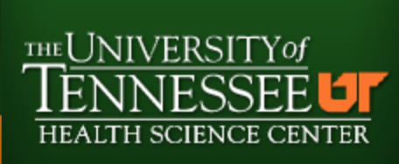
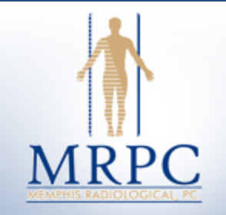
UT/Methodist university
Radiology residency

Slide 2
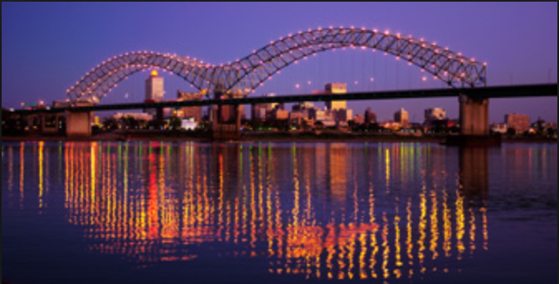
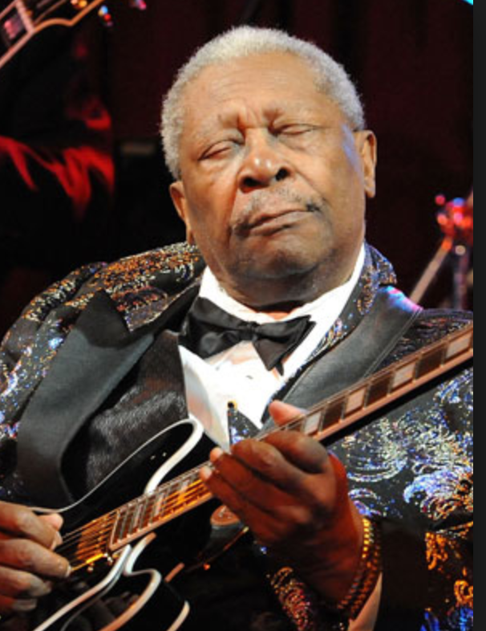
WELCOME TO MEMPHIS!
Population around 655,000 for city limits
and 1.3 million for metro area (in 2012)
“The Bluff City” on the Mississippi River
“The Birthplace of the Blues”
“The Birthplace of Rock n’ Roll”
“The BBQ Pork Capital of the World”
Oh yeah, and the birthplace of this guy

Slide 3
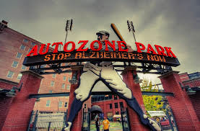
Sports!

Slide 4
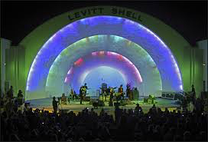
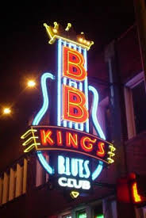
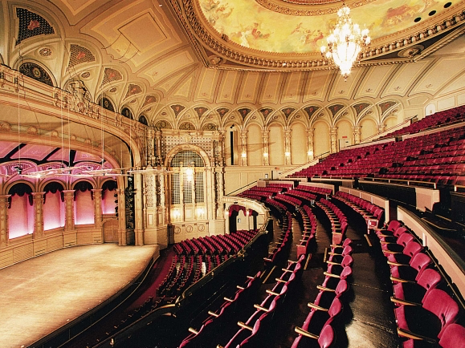
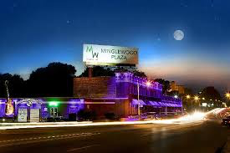
MuSIC!

Slide 5
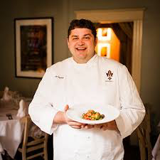
FOOD and Drinks!

Slide 6
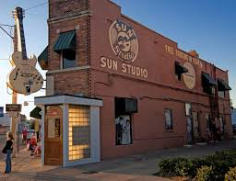
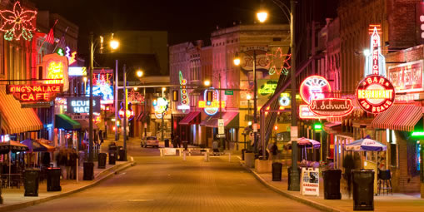
Attractions!

Slide 7
EvEnts!

Slide 8
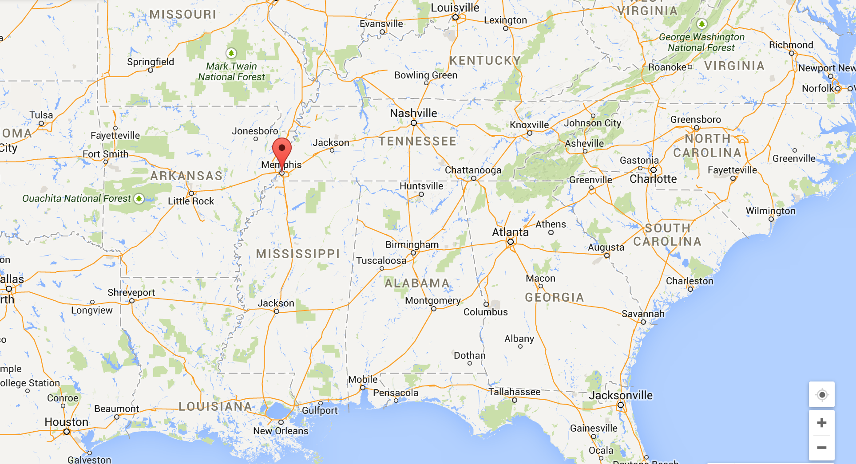
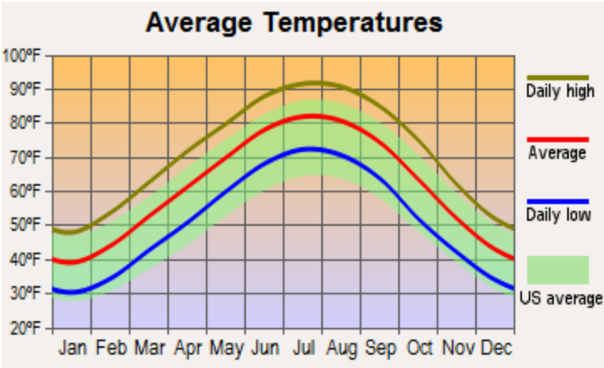
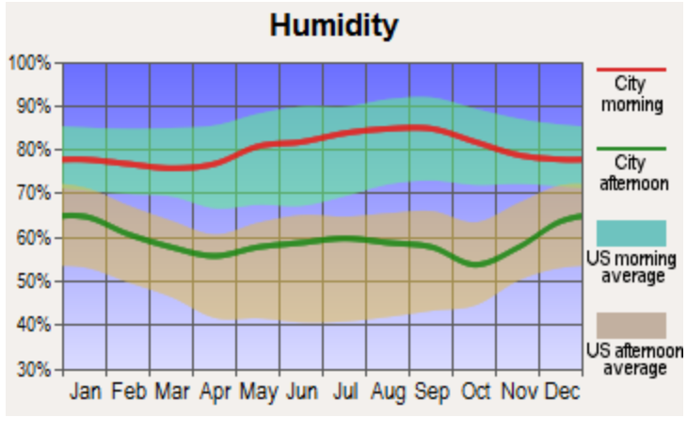
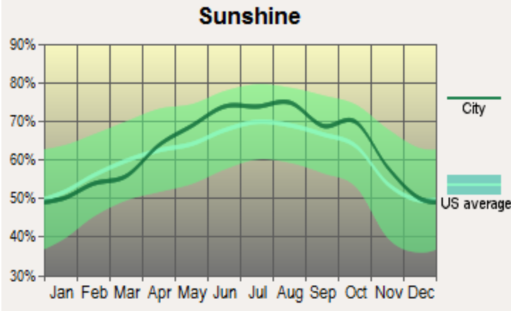
Where you are
Central time zone
Population 655,000 (2012)
Arkansas across the bridge
Mississippi 5 miles S
Nashville 3 hours E
Birmingham 3 hours SE
Temperate climate with plentiful sunshine, 4 seasons, and variable years of snowfall
Thanks to city-data.com

Slide 9
Housing
Cost of living in Memphis is less than that of the national average!!!
Many apartment / condo / home options in Memphis city limits:
Downtown – up and coming, mostly apartments and condos, walking distance to Beale Street and a number of restaurants
Mud Island – many apartment / condo / home options where a number of medical students and residents live
Midtown – traditionally older homes with lots of charm, most 20-40y/o from Memphis live in this area of town
Highpoint – plenty of affordable homes where a number of young families live
East Memphis – mostly newer construction homes
Many other options outside the city limits in suburbs including Collierville, Cordova, Bartlett, etc.
Easy to get around town via I-240 and I-40 (currently under construction at this intersection!)

Slide 10
About our program
6 residents per year, and currently with 27 residents
Home base is here at Methodist University Hospital!
We have conference every morning at 7am (except 7:30 at St. Jude) and optional noon conference on Fridays at The MED. The work day generally ends around 4:30-5pm depending on your site of coverage.
We work at several different hospital systems:
Methodist Hospital System
University, North, South, and Germantown
Minor Meds and Outpatient Centers
Able to read for entire system from one site
Regional One Health / The MED
regional level one trauma center
VA Medical Center
LeBonheur
regional pediatric level one trauma center
St. Jude Children’s Hospital

Slide 11
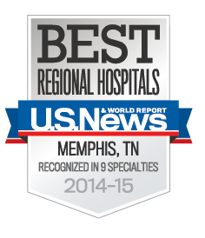
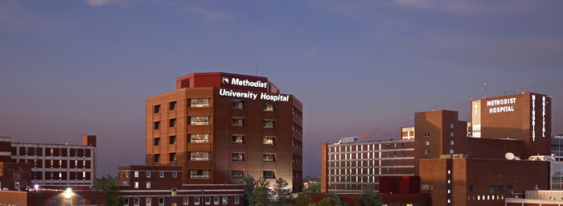
Methodist Healthcare System
Largest Healthcare provider in the Region
Large liver and kidney transplant center
Mixed academic and private practice radiology group which is the primary source of teaching faculty
Site of Transitional Year Program

Slide 12
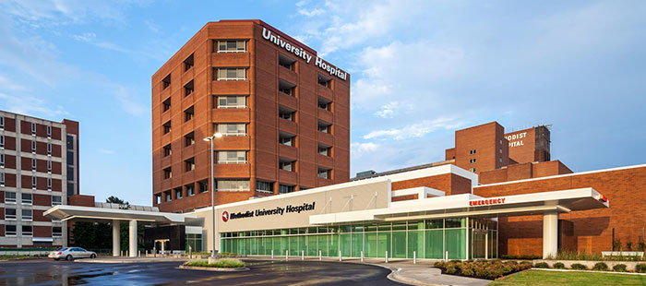
Quick Facts
Total admissions – 63,371
Total outpatient visits – 343,287
Surgical procedures – 39,507 (inpatient & outpatient
)Newborn admissions (births) – 5,702
Total licensed beds – 1,725
Total associates – 12,388
Figures from 2013

Slide 13
Methodist has been named the Best Hospital in Memphis once again by U.S. News and World Report. Of all 25 hospitals in the Memphis.

Slide 14
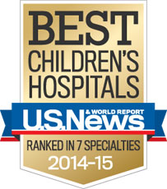
Le Bonheur Children's Hospital is one of the nation's best children's hospitals, featuring expert physicians and staff, state-of-the-art technology and family-friendly resources.
Largest children’s hospital in region
Only local children’s hospital which treats all disease
Excellent neurosurgical referral center
Great subspecialty training in all areas, including pediatric neuroradiology
Twice monthly conferences at Lebonheur, with focus on pediatric neuroradiology

Slide 15
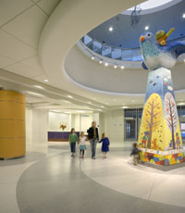
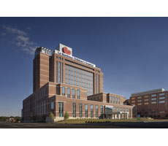
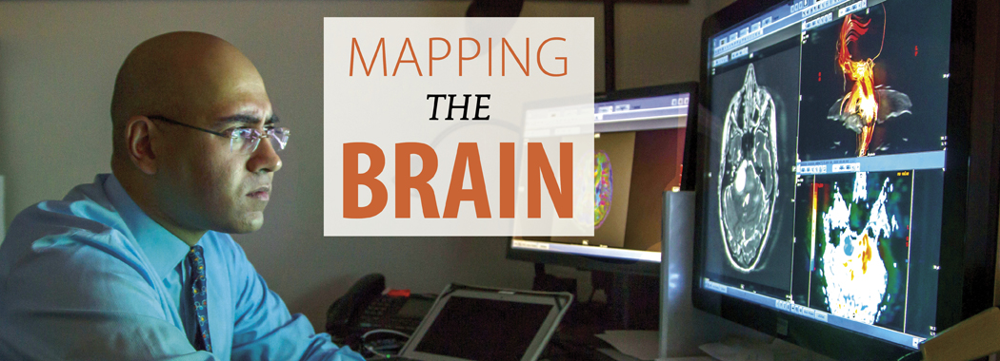

Slide 16
St. Jude Children’s Research Hospital is internationally recognized for its pioneering research and treatment of children with cancer and other catastrophic diseases. Ranked one of the best pediatric cancer hospitals in the country, St. Jude is the first and only National Cancer Institute-designated Comprehensive Cancer Center devoted solely to children.
Pediatric oncology rotations focus on body or neuroradiology.
Residents spend at least two months here during residency.
Monthly morning conferences with experts in the field.

Slide 17
No Place Like St. Jude
Families never receive a bill from St. Jude for treatment, travel, housing and food – because all a family should worry about is helping their child live.
Treatments invented at St. Jude have helped push the overall childhood cancer survival rate from 20 percent to more than 80 percent since it opened in 1962.
St. Jude is working to drive the overall survival rate for childhood cancer to 90 percent in the next decade. We won’t stop until no child dies from cancer.
St. Jude freely shares the breakthroughs we make, and every child saved at St. Jude means doctors and scientists worldwide can use that knowledge to save thousands more children
.Because the majority of St. Jude funding comes from individual contributors, St. Jude has the freedom to focus on what matters most – saving kids regardless of their financial situation.
St. Jude was founded by the late entertainerDanny Thomas, who believed that “No child should die in the dawn of life.”
By the Numbers
St. Jude has treated children from all 50 states and around the world.
On average, St. Jude has more than 67,000 patient visits each year.
We shared our research results in 775 articles published in peer-reviewed journals in 2012. That equals, on average, a new discovery shared every 11 hours.
St. Jude has been recognized by FORTUNE magazine as one of the “100 Best Companies to Work For,” by The Scientist as one of the top 10 “Best Places to Work in Academia,” and by U.S. News & World Report and Parents magazine as a top children’s cancer hospital.
The daily operating cost for St. Jude is $2 million, which is primarily covered by individual contributions.

Slide 18
Regional Medical Center: home to Centers of Excellence in Trauma (Level 1), Burn, High-Risk Obstetrics and Neonatal Intensive Care.
Excellent trauma surgery service at one of the top 5 trauma centers in the nation
Indigent care as well
Private practice radiology group within an academic setting
Neonatal intensive care unit, though films read across the street at LeBonheur

Slide 19
Regional Medical Center (aka ‘The Med’)
A major addition to the system of care for the critically injured patient is the Presley Regional Trauma Center, which opened in 1983. This center has become one of the highest-volume centers in the United States. Over 4500 patients a year sustaining both blunt and penetrating injury are managed using the trauma team concept. Diagnostic, operative, and intensive care faculty supervision, together with a multispecialty team approach, ensures both optimal patient care and excellent resident education. The center receives patients not only from the Memphis metropolitan area but also by helicopter from North Mississippi, Eastern Arkansas, Southern Missouri and West Tennessee within a 150 mile radius.

Slide 20
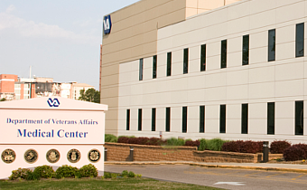
Memphis VA Medical Center
Fantastic plain film and fluoroscopic radiology training
Some half-day rotations allow for personal study time
New, young staff

Slide 21
Lectures
One to two lectures each morning
Faculty in each specialty devises curriculum for annual or biannual complete lecture series so that residents see everything multiple times before boards
Assigned readings and books to prepare for boards starting the first day

Slide 22
Research Opportunities
St. Jude is a world-renowned Research Hospital which participates in national trials and runs phase 1-4 trials on site.
Faculty welcome resident participation in their own research initiatives and support residents pursuit of their own research.
LeBonheur staff are all engaged in active clinical research. One can easily find research opportunities.
Methodist staff and Regional One Healtcare staff support research, typically focusing on case-driven projects rather than trials or large clinical research or meta-data.

Slide 23
Teaching Opportunities
Many options to teach, both residents and medical students.
Residents actively participate in teaching medical students on the rotation and give weekly conferences.
Residents participate in multi-disciplinary conferences with family medicine and internal medicine.
R1s teach radiology technology students.

Slide 24
Educational Fund
While this is subject to change on occasion, we still proudly have one of the best book funds in the country.
Stipend of $12,000 over 3 years
$3,000 each year for R1 and R2
$6,000 for R3 year as this year includes AIRP and the core examination
Each resident may purchase one computer and one tablet during residency with their book fund.
As long as purchases are deemed educational, there is significant latitude for what this money can be used.
Presentations at meetings is funded separately from dedicated individual education fund as described above.

Slide 25
Board Prep
100% board pass rate in 2014.
Educational fund can be used for Core Examination preparation courses
Dedicated morning lectures for board prep in the three months prior to the core examination
Faculty lectures have been adjusted to account for the new format
Faculty willing to meet after work and over lunch for preparation sessions with the class taking the examination
Currently arranging an in-house Physics Review Course with a nationally recognized medical physicist who has given review courses for years (Ted Villifana, Ph.D.)

Slide 26
Websites may find useful
http://www.overtonsquare.com/eat-shop-enjoy/
http://www.choose901.com
http://www.memphisflyer.com/blogs/HungryMemphis/
http://www.ilovememphisblog.com/

