Slide 1
The Resident as a Professional in Radiology
Self-Learning Module
Association of Program Directors in Radiology (APDR)
Alliance of Medical Student Educators in Radiology (AMSER)
Andrea Donovan, MD
Sravanthi Reddy, MD
Christopher Straus, MD
Petra Lewis, MD

Slide 2
APDR Resident Professionalism Module
2
This presentation MUST be in slide show for hyperlinks to work properly.
This module is designed for radiology residents. At the completion of this module, the participant will be able to:
define professionalism elements in medicine
apply these elements to radiology scenarios
disclosure of commercial interest
The authors are not aware of any commercial interest or any conflicts-of-interest with regard to this resident learning module.

Slide 3
APDR Resident Professionalism Module
3
module start
pretest
professionalism in medicine
professionalism in radiology
skills
behaviors
service
posttest
Module outline
pretest
professionalism in medicine
professionalism in radiology
skills and standards / intro, cases, questions
behaviors / intro, cases, questions
service / intro, cases, questions
posttest
Use the panel on the right to navigate between sections

Slide 4
APDR Resident Professionalism Module
4
1. Pretest
Please answer the following five questions related to case scenarios. Write down your responses.
The same questions will be asked at the conclusion of this module, with correct answers and explanations provided.
module start
pretest
professionalism in medicine
professionalism in radiology
skills
behaviors
service
posttest

Slide 5
Pretest
APDR Resident Professionalism Module
5
module start
pretest
professionalism in medicine
professionalism in radiology
skills
behaviors
service
posttest
1. Your 10-year-old daughter is a patient at your medical center. Are you allowed to access the electronic medical record to check her x-ray results?
Yes, because she is your daughter
Yes, because she is under 16
No, because you are not her physician
No, because she has not given written consent

Slide 6
Pretest
APDR Resident Professionalism Module
6
module start
pretest
professionalism in medicine
professionalism in radiology
skills
behaviors
service
posttest
2. A sales representative from a leading CT manufacturer gives you a laser pointer labeled with the company name. Can you accept this gift?
Yes, because its value is <$50
Yes, because you are not buying their equipment
No, as it is labeled with the company name
No, as gifts should not be accepted from commercial companies

Slide 7
Pretest
APDR Resident Professionalism Module
7
module start
pretest
professionalism in medicine
professionalism in radiology
skills
behaviors
service
posttest
3. An attractive patient flirts openly with you during an upper GI study. How should you react?
Refuse to have any further contact with the patient
Tell the patient you are not interested and to stop flirting
Include a chaperone at future meetings and if it continues inform your attending
Make a date to see him/her after you are off the service

Slide 8
Pretest
APDR Resident Professionalism Module
8
module start
pretest
professionalism in medicine
professionalism in radiology
skills
behaviors
service
posttest
4. You are on call with a radiology fellow and you smell alcohol on his breath. How should you manage this situation?
Ignore it as he does not appear drunk
Confront him with your suspicions
Call the attending on-call that night
Talk to the residency director the next day

Slide 9
Pretest
APDR Resident Professionalism Module
9
module start
pretest
professionalism in medicine
professionalism in radiology
skills
behaviors
service
posttest
5. Can you use patient images for a presentation at a national meeting?
Under no circumstances
Only if you sign a waiver
If the patient signs a waiver
If the information is de-identified

Slide 10
Professionalism in medicine
APDR Resident Professionalism Module
10
Professionalism in Medicine
module start
pretest
professionalism in medicine
professionalism in radiology
skills
behaviors
service
posttest
“Professionalism is the basis of medicine’s contract with society”
Ann Inter Med 136:243, 2002
when professionalism is absent
patient care suffers
the work environment is degraded
medical errors increase
Notes:
Physicians and the public recognize the need for high moral standards and accountability in medicine. Most commonly, the focus of concern involves physician competence and integrity, as demonstrated by such measures as board certification, hospital credentialing, peer review of practice, participation in impaired physician programs, and malpractice litigation. Physician behavior is guided by various practice guidelines, review articles, policy statements by professional organizations, and applicable laws and regulations. Codes of ethics for physicians have a role in addressing personal and other nontechnical aspects of physician conduct, as exemplified by the American Medical Association’s periodically updated code (Pediatrics 2009;124;1685-1688 Committee on Bioethics Pediatrician-Family-Patient Relationships: Managing the Boundaries)

Slide 11
Professionalism in medicine
APDR Resident Professionalism Module
11
module start
pretest
professionalism in medicine
professionalism in radiology
skills
behaviors
service
posttest
professional
a person who uses specialized skills in the service of others, conforms to the technical or ethical standards of a profession, and exhibits a courteous and conscientious behavior

Slide 12
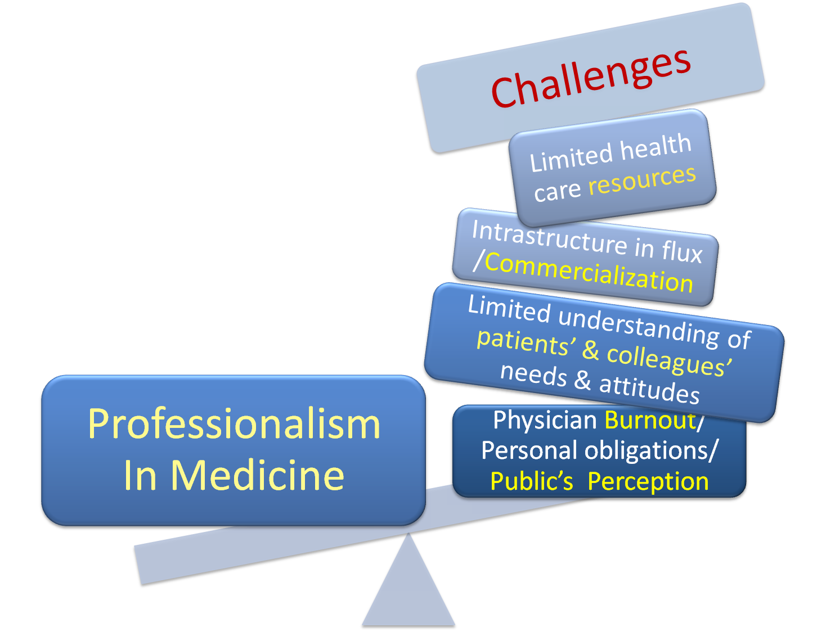
Professionalism in medicine
APDR Resident Professionalism Module
12
Challenges to professionalism
module start
pretest
professionalism in medicine
professionalism in radiology
skills
behaviors
service
posttest

Slide 13
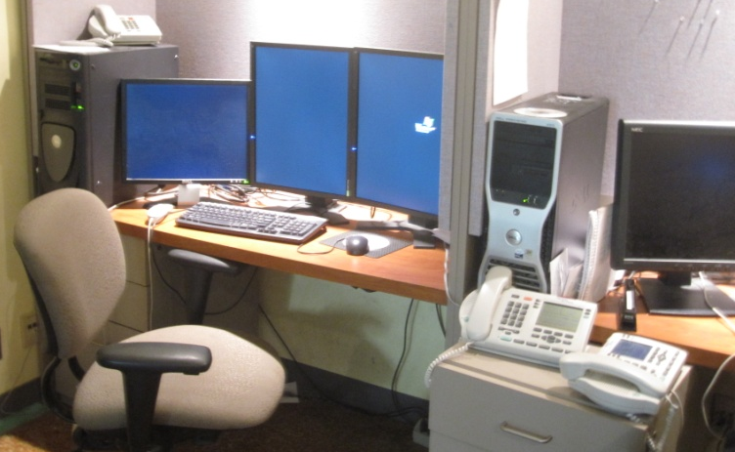
APDR Resident Professionalism Module
13
radiologists face additional challenges because of the specialized nature of their practice
module start
pretest
professionalism in medicine
professionalism in radiology
skills
behaviors
service
posttest
infrequent contact with patients
infrequent contact with clinicians
Residents on radiology rotations may also face the challenges of insufficiently defined roles.

Slide 14
Professionalism in radiology
APDR Resident Professionalism Module
14
professionalism in radiology demands commitment to established standards of:
module start
pretest
professionalism in medicine
professionalism in radiology
skills
behaviors
service
posttest
professional competence
scientific knowledge
improving quality of care
professional responsibilities
honesty with patients
patient confidentiality
appropriate patient relationships
improving access to care
just distribution of finite resources
managing conflicts of interest
skills
behaviors
social justice & service
Notes:
Statement on Professionalism
Professionalism is the basis of medicine's contract with society, placing the interests of patients above those of the physician, setting and maintaining standards of competency and integrity, and providing expert advice to society on matters of health—in short, a contract that addresses issues of ethics, knowledge, and communication. In practice, professionalism encompasses a set of beliefs, values, and behaviors that reflect commitments.

Slide 15
Professionalism in radiology / skills
APDR Resident Professionalism Module
15
1. professional competence and scientific knowledge
module start
pretest
professionalism in medicine
professionalism in radiology
skills
behaviors
service
posttest
individual
commitment to
lifelong learning
creation and spread new knowledge
medical community commitment to
high standards
rigorous assessment of member competence
Notes:
Commitment to Professional Competence
Physicians must be committed to lifelong learning and be responsible for maintaining the medical knowledge and clinical and team skills necessary for the provision of quality care. More broadly, the profession as a whole must strive to see that all of its members are competent and must ensure that appropriate mechanisms are available for physicians to accomplish this goal.

Slide 16
Professionalism in radiology / skills
APDR Resident Professionalism Module
16
2. Improving Quality of Care
module start
pretest
professionalism in medicine
professionalism in radiology
skills
behaviors
service
posttest
clinical competence
ongoing process through professional career
collaborative work
reduce medical error
increase patient safety
maximize resources
optimize outcomes
Notes:
Commitment to improving quality of care
Physicians must be dedicated to continuous improvement in the quality of healthcare. This commitment entails not only maintaining clinical competence but also working collaboratively with other professionals to reduce medical error, increase patients’ safety, minimize overuse of healthcare resources, and optimize the outcomes of care. Physicians must actively participate in the development of better measures of quality of care and the application of quality measures to assess routinely the performance of all individuals, institutions, and systems responsible for healthcare delivery. Physicians, both individually and through their professional associations, must take responsibility for assisting in the creation and implementation of mechanisms designed to encourage continuous improvement in the quality of care.

Slide 17
Professionalism in radiology / skills
APDR Resident Professionalism Module
17
Commitment to Improving Quality of Care
module start
pretest
professionalism in medicine
professionalism in radiology
skills
behaviors
service
posttest
effective collaboration is essential, and involves
accessing clinical information on a patient
timely reporting of critical findings to clinician
clear noting of discrepancies in on-call report
thorough documentation of all communication with clinicians in patient record

Slide 18
Professionalism in radiology / skills
APDR Resident Professionalism Module
18
case
1
While you are on MSK rotation, the ED physician requests a CT of the foot in a diabetic patient to rule out osteomyelitis. What should be your next step?
module start
pretest
professionalism in medicine
professionalism in radiology
skills
behaviors
service
posttest
Approve and schedule the exam
Refuse to perform the exam
Refer to the ACR Appropriateness Criteria®
Ask if the patient had foot radiographs already

Slide 19
Professionalism in radiology / skills
APDR Resident Professionalism Module
19
case
1
correct answer is “C”
refer to the ACR Appropriateness Criteria
module start
pretest
professionalism in medicine
professionalism in radiology
skills
behaviors
service
posttest
Before accepting a consult, confirm that the imaging test is appropriate. If you are unsure, refer to the ACR Appropriateness Criteria®.
You also need to be aware of relevant clinical history including allergies, labs and contraindications to imaging tests.
The uncritical use of high-tech medical imaging
N Engl J Med. 2010 Jul 1;363(1):4-6
Notes:
The uncritical use of high-tech medical imaging.
Hillman BJ, Goldsmith JC.
N Engl J Med. 2010 Jul 1;363(1):4-6. Epub 2010 Jun 23.

Slide 20
Professionalism in radiology / skills
APDR Resident Professionalism Module
20
case
1
Discussion
Essential information to obtain in a radiology consult:
module start
pretest
professionalism in medicine
professionalism in radiology
skills
behaviors
service
posttest
Referrer name and contact number (e.g., pager)
Patient age, gender, current location
Clinical history
If female: LMP, bHCG/urine pregnancy test if premenopausal if any question of pregnancy (especially CT, or interventional fluoroscopy procedure)
Prior imaging tests: e.g., plain radiographs
Contraindications: e.g., creatinine level, devices
Mobility or mental status problems
If procedure: lab values (PT, PTT, INR), medications (e.g., anticoagulants), allergies, consent ability

Slide 21
Professionalism in radiology / skills
APDR Resident Professionalism Module
21
case
2
During review of on-call CT scans, the radiology attending you are working with identifies a 5-cm AAA in a patient who came to emergency room last night for
module start
pretest
professionalism in medicine
professionalism in radiology
skills
behaviors
service
posttest
renal colic. The preliminary report described the ureter stone, but not the AAA. Which of the following is the appropriate next step?
Report the findings in the final written report
Speak with the physician taking care of the patient
Email or text the physician with the result

Slide 22
Professionalism in radiology / skills
APDR Resident Professionalism Module
22
case
2
correct answer is “B”:
Speak with the physician taking care of the patient.
module start
pretest
professionalism in medicine
professionalism in radiology
skills
behaviors
service
posttest
Critical findings must be relayed to the responsible physician either verbally or by electronic media like email or text messaging. (For electronic media a confirmation of message receipt must be obtained.)
It is essential to document in the final report the name of the physician and the time of communication of discrepant or critical results.
Raskin. The Perils of Communicating the Unexpected Finding J Am Coll Radiol 2010;7:791-795
Failure of radiologic communication: An increasing cause of malpractice litigation and harm to patients
Applied Radiology; Vol 39, Number 1-2. January 2010
Notes:
Failure of radiologic communication: An increasing cause of malpractice litigation and harm to patients
Applied Radiology; Vol 39, Number 1-2. January 2010

Slide 23
Professionalism in radiology / behaviors
APDR Resident Professionalism Module
23
3. Professional Responsibilities
module start
pretest
professionalism in medicine
professionalism in radiology
skills
behaviors
service
posttest
maintain collaborative and respectful relationships,
treating everyone as you would want to be treated
colleagues
support staff
referring staff
be prepared to report colleagues for unprofessional behavior
substance abuse
inadequate care
unethical behavior
boundary violations (patients or staff)
Notes:
source: Improving Patient Safety in Radiology, Radiology 2006
Commitment to professional responsibilities
As members of a profession, physicians are expected to work collaboratively to maximize patient care, be respectful of one another, and participate in the processes of self-regulation, including remediation and discipline of members who have failed to meet professional standards. The profession should also define and organize the educational and standard-setting process for current and future members. Physicians have both individual and collective obligations to participate in these processes. These obligations include engaging in internal assessment and accepting external scrutiny of all aspects of their professional performance.

Slide 24
Professionalism in radiology / behaviors
APDR Resident Professionalism Module
24
case
3
For a radiology conference abstract, your attending asks you to obtain clinical history for the cases. This information isn’t readily available, and with the deadline next week, the fellow who is also on the abstract offers to make up the histories. What would you do?
module start
pretest
professionalism in medicine
professionalism in radiology
skills
behaviors
service
posttest
Go along with the idea – who would know?
Tell the fellow that you do not like the idea and will report him or her to the attending if he does
Delete the cases that don’t have the information
Explain to the attending the problems and ask how you should proceed

Slide 25
Professionalism in radiology / behaviors
APDR Resident Professionalism Module
25
case
3
correct answer is “D”:
Explain to the attending the problems
and ask how you should proceed.
You need accurate reporting and analysis of research data, even for educational exhibits.
If information is vital to the exhibit and cannot be obtained in time, it should not be submitted.
There are professional and legal repercussions to inaccurate data gathering - especially if intentional.
All authors are responsible for contents.
module start
pretest
professionalism in medicine
professionalism in radiology
skills
behaviors
service
posttest


Slide 26
Professionalism in radiology / behaviors
APDR Resident Professionalism Module
26
4. Honesty with Patients
module start
pretest
professionalism in medicine
professionalism in radiology
skills
behaviors
service
posttest
state your level of training/experience
know how to discuss of imaging results with patients
know how to obtain informed consent for procedures
American College of Radiology (ACR) practice guideline for communication of diagnostic imaging findings.
Smith and Gunderman. Should We Inform Patients of Radiology Results? Radiology 2010 255:317-21
Notes:
links:
Should We Inform Patients of Radiology Results? Radiology 2010 255:317-21
ACR PRACTICE GUIDELINE ON INFORMED CONSENT FOR IMAGE-GUIDED PROCEDURES
Commitment to Honesty with Patients
Physicians must ensure that patients are completely and honestly informed before the patient has consented to treatment and after treatment has occurred. This expectation does not mean that patients should be involved in every minute decision about medical care; rather, they must be empowered to decide on the course of therapy. Physicians should also acknowledge that, in healthcare, medical errors that injure patients do sometimes occur. Whenever patients are injured as a consequence of medical care, patients should be informed promptly because failure to do so seriously compromises patients' and societal trust. Reporting and analyzing medical mistakes provides the basis for appropriate prevention and improvement strategies and for appropriate compensation to injured parties.

Slide 27
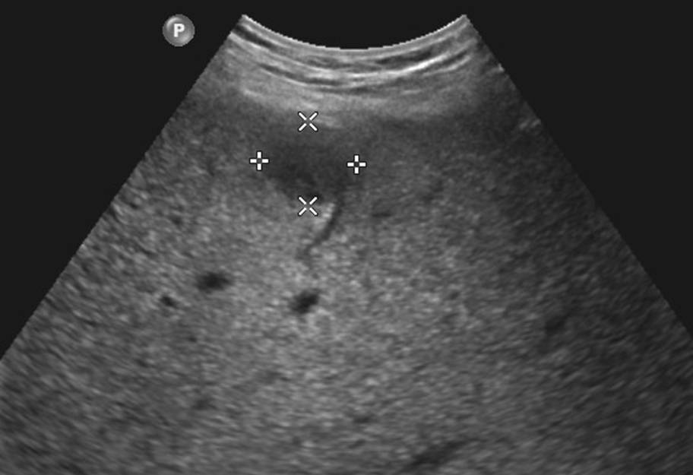
Professionalism in radiology / behaviors
APDR Resident Professionalism Module
27
case
4
While you are doing an RUQ US, you see what you think is a mass in the liver. The patient asks, “What do you see?”What would you say?
module start
pretest
professionalism in medicine
professionalism in radiology
skills
behaviors
service
posttest
“Nothing, really. I’m sure everything is fine.”
“I’m a resident – the radiologist will look and make a final interpretation.”
“You have a liver lesion that must be further evaluated.”
“I’m sorry – but I think you have cancer.”

Slide 28
Professionalism in radiology / behaviors
APDR Resident Professionalism Module
28
case
4
correct answer is “B”
“I’m a resident. The radiologist will look and make a final interpretation.”
module start
pretest
professionalism in medicine
professionalism in radiology
skills
behaviors
service
posttest
Balance being honest, supportive, yet not overstepping your boundaries as a resident.
Ask your attending to show you how to discuss results with patients, observe you do it and give you feedback.
Notes:
Failure of radiologic communication: An increasing cause of malpractice litigation and harm to patients
Applied Radiology; Vol 39, Number 1-2. January 2010

Slide 29
Professionalism in radiology / behaviors
APDR Resident Professionalism Module
29
5. Patient Confidentiality
module start
pretest
professionalism in medicine
professionalism in radiology
skills
behaviors
service
posttest
keep patient’s issues private
remove patient information from images before using for conferences, exhibits, publications

If “cropping” information on downloaded images, confirm that it cannot be reversed to original size containing information
Notes:
Commitment to patient confidentiality
Earning the trust and confidence of patients requires that appropriate confidentiality safeguards be applied to disclosure of patient information. This commitment extends to discussions with persons acting on a patient's behalf when obtaining the patient's own consent is not feasible. Fulfilling the commitment to confidentiality is more pressing now than ever before, given the widespread use of electronic information systems for compiling patient data and an increasing availability of genetic information. Physicians recognize, however, that their commitment to patient confidentiality must occasionally yield to overriding considerations in the public interest (for example, when patients endanger others).

Slide 30
Professionalism in radiology / behaviors
APDR Resident Professionalism Module
30
case
5
During an US exam on a 16 y/o girl for RLQ pain, the patient states, “Please don’t tell my mother, but I might be pregnant.” What would you do?
module start
pretest
professionalism in medicine
professionalism in radiology
skills
behaviors
service
posttest
Do nothing.
Tell the mother.
Tell the patient to tell the mother or that otherwise you will.
Tell the attending radiologist so he or she can inform the primary care physician.

Slide 31
Professionalism in radiology / behaviors
APDR Resident Professionalism Module
31
case
5
correct answer is “D”:
Tell the attending radiologist so he or she can inform the referring physician.
module start
pretest
professionalism in medicine
professionalism in radiology
skills
behaviors
service
posttest
This may relate to the patient’s symptoms and will need to be pursued by her physician with a pregnancy test, who can discuss the results with the patient.

Slide 32
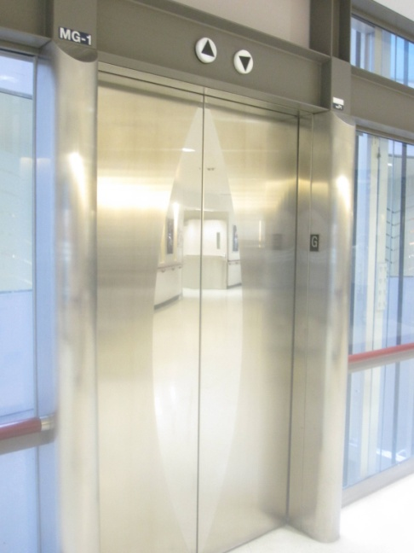
Professionalism in radiology / behaviors
APDR Resident Professionalism Module
32
module start
pretest
professionalism in medicine
professionalism in radiology
skills
behaviors
service
posttest
case
6
You are in an elevator and hear an interesting discussion of a patient’s case. The name of the patient is not mentioned.
Does this violate patient confidentiality?

Slide 33
Professionalism in radiology / behaviors
APDR Resident Professionalism Module
33
module start
pretest
professionalism in medicine
professionalism in radiology
skills
behaviors
service
posttest
case
6
correct answer is “YES”
The case might have other identifiers such as diagnosis, patient location
NO patient information should be discussed in a public forum
You can suggest to the discussants to continue the conversation in another location
Privacy of patients' information in hospital lifts: observational study BMJ 2003:327;1024

Slide 34
Professionalism in radiology / behaviors
APDR Resident Professionalism Module
34
case
7
module start
pretest
professionalism in medicine
professionalism in radiology
skills
behaviors
service
posttest
A celebrity that you admire is admitted to the hospital. You want to look at their images on the PACS system. When is this allowed?
If you will be taking care of the patient
If you are only looking and won’t be saving the data
If you are only looking and won’t be showing the images to your friends or others
Never

Slide 35
Professionalism in radiology / behaviors
APDR Resident Professionalism Module
35
case
7
module start
pretest
professionalism in medicine
professionalism in radiology
skills
behaviors
service
posttest
correct answer is “A”:
Only if you will be taking care of the patient.
The same applies to ANY patient including colleagues, friends, family
There are legal consequences to unauthorized access, which can be tracked

Slide 36
Professionalism in radiology / behaviors
APDR Resident Professionalism Module
36
6. Appropriate Patient Relationships
module start
pretest
professionalism in medicine
professionalism in radiology
skills
behaviors
service
posttest
boundaries
appearance
language
gifts
Given the inherent vulnerability and dependency of patients, certain relationships between physicians and patients must be avoided. In particular, physicians should never exploit patients for any sexual advantage, personal financial gain, or other private purpose.
Notes:
Commitment to Maintaining Appropriate Relationships with Patients
Given the inherent vulnerability and dependency of patients, certain relationships between physicians and patients must be avoided. In particular, physicians should never exploit patients for any sexual advantage, personal financial gain, or other private purpose

Slide 37
Professionalism in radiology / behaviors
APDR Resident Professionalism Module
37
case
8
While you are on an obstetric ultrasound rotation, a patient undergoing an ultrasound for a high risk pregnancy asks you to be friends on Facebook so you can see pictures of her baby after delivery.
Does this violate patient confidentiality?
module start
pretest
professionalism in medicine
professionalism in radiology
skills
behaviors
service
posttest
facebook

Slide 38
Professionalism in radiology / behaviors
APDR Resident Professionalism Module
38
case
8
Discussion
module start
pretest
professionalism in medicine
professionalism in radiology
skills
behaviors
service
posttest
Do not accept invitations to social networking sites because of privacy concerns
Potential harm to therapeutic relationship/denial of insurance
Limit personal information on your own site
consider what you would want your patients to know about you
use appropriate photographs only
do not discuss your patients, colleagues or attendings



Medical professionalism in the age of online social networking. J Med Ethics 2009;35:584–586
Notes:
Medical professionalism in the age of online social networking. J Med Ethics 2009;35:584–586

Slide 39
Professionalism in radiology / behaviors
APDR Resident Professionalism Module
39
case
9
module start
pretest
professionalism in medicine
professionalism in radiology
skills
behaviors
service
posttest
You become attracted to a patient who has returned several times for spontaneous pneumothoraces. The patient senses this and asks you to go out for dinner. You explain that you cannot because of respect for the patient-physician relationship.
One year later, however, you meet this former patient at the gym and agree to go out for coffee.
Would this be considered professional behavior by your state licensing body?

Slide 40
Professionalism in radiology / behaviors
APDR Resident Professionalism Module
40
case
9
module start
pretest
professionalism in medicine
professionalism in radiology
skills
behaviors
service
posttest
Discussion
Legally there is ambiguity, as state laws differ.
Ethically the clearest guideline is given by the American Medical Association, which advises that such relationships are never appropriate.
in general . . .

no outside relationship within one year of treatment
psychotherapy: lifetime ban

Notes:
Sex and the doctor–patient relationship.
NZ Med J 1997

Slide 41
Professionalism in radiology / behaviors
APDR Resident Professionalism Module
41
case
9
module start
pretest
professionalism in medicine
professionalism in radiology
skills
behaviors
service
posttest
Discussion
Why is initiation of a friendship or romantic relationship with your patient not acceptable?
physician has a fiduciary relationship to the patient
physician is responsible for managing boundaries
Fiduciary: held or founded in trust or confidence

Slide 42
Professionalism in radiology / behaviors
APDR Resident Professionalism Module
42
appropriate patient relationships
module start
pretest
professionalism in medicine
professionalism in radiology
skills
behaviors
service
posttest
How can you manage boundary transgression with a patient if it happens?
recognize transgression has occurred
2. manage transgression
Divert patient approaches discretely & tactfully
Communicate & document (e.g., letter) with supervisor
3. prevent future transgression
Recognize early signs of transgression in your own & patient’s behavior
Examine boundaries and methods of preventing transgression

Slide 43
Professionalism in radiology / behaviors
APDR Resident Professionalism Module
43
appropriate patient relationships
module start
pretest
professionalism in medicine
professionalism in radiology
skills
behaviors
service
posttest
How can you ensure your appearance is appropriate?
?
consider your intent when you choosing your outfit
attire should not embarrass or distance patient
ensure your attire is clean
avoid under-dressing (torn, tight, short, revealing)
avoid over-dressing (e.g.,very expensive clothes)
avoid fragrances
may trigger asthma, allergy, migraine headache

Slide 44
Professionalism in radiology / behaviors
APDR Resident Professionalism Module
44
appropriate patient relationships
module start
pretest
professionalism in medicine
professionalism in radiology
skills
behaviors
service
posttest
How can you ensure your language with the patient is appropriate?
Address the patients formally (Mr., Mrs., Ms.) unless they offer informal address
Avoid overly-familiar address, e.g., “dear,” “honey”
Avoid jargon and condescending language: offer explanations at the patient’s level but not below it
Be sensitive to the patient’s state of mind, e.g., how anxiety can affect the patient’s responses
Be careful about the impact of humor: not everyone will “get it” or respond as you intended

Slide 45
Professionalism in radiology / behaviors
APDR Resident Professionalism Module
45
case
10
module start
pretest
professionalism in medicine
professionalism in radiology
skills
behaviors
service
posttest
During an US-guided breast biopsy, a colleague asks you if you watched the game the previous night.
How would you respond?
You discuss the game with the other resident, while ignoring the patient
You ignore the other resident and concentrate on watching the patient procedure
You respond to the other resident, but involve the patient in the discussion, ready to change the subject if the patient is not interested

Slide 46
Professionalism in radiology / behaviors
APDR Resident Professionalism Module
46
case
10
module start
pretest
professionalism in medicine
professionalism in radiology
skills
behaviors
service
posttest
Correct answer is “C”
You can respond to the other resident, but involve the patient in the discussion, ready to change the subject if the patient is not interested.
Be sensitive to the patient’s comfort and peace of mind.
at times, “small talk” can help relax a patient—but involve them in the conversation.
at other times, it can be annoying—many patients prefer silence.

Slide 47
Professionalism in radiology / behaviors
APDR Resident Professionalism Module
47
case
11
module start
pretest
professionalism in medicine
professionalism in radiology
skills
behaviors
service
posttest
On a radiology rotation, as you are consenting a 75-year-old female patient for a biopsy, she jokes about how young you look. How would you respond?
Ignore the patient’s comment.
Tell the patient it’s thanks to Botox, and she should try it too.
Offer supportive remarks and explore her concerns.
Consider potential consequences to each of the above actions! (see next page)

Slide 48
Professionalism in radiology / behaviors
APDR Resident Professionalism Module
48
case
11
module start
pretest
professionalism in medicine
professionalism in radiology
skills
behaviors
service
posttest
best answer is “C”
If you ignore the patient you convey a lack of interest or attention.
The patient may misperceive a comment. For example, the patient might feel put down and there may be a barrier to communication.
You should explore if the patient feels anxious and try to minimize the patient’s concerns by offering empathetic comments to show you understand.
e.g., “Yes, I know, I get that a lot. But don’t worry, I am supervised by a radiology attending during the procedure.”
Notes:
Failure of radiologic communication: An increasing cause of malpractice litigation and harm to patients
Applied Radiology; Vol 39, Number 1-2. January 2010

Slide 49
Professionalism in radiology / behaviors
APDR Resident Professionalism Module
49
case
12
module start
pretest
professionalism in medicine
professionalism in radiology
skills
behaviors
service
posttest
The parents of a pediatric patient offer you tickets to a game in appreciation for arranging a CT scan. How should you respond?
You say you cannot accept gifts from patients.
You say thank you warmly, accept the gift, and say there was absolutely no need for the gift.
You say thank you, that the team is your favorite and it is a pleasure to be given these tickets as a gift.

Slide 50
Professionalism in radiology / behaviors
APDR Resident Professionalism Module
50
case
12
module start
pretest
professionalism in medicine
professionalism in radiology
skills
behaviors
service
posttest
Discussion
Institutional policies vary from “no gift” to a specific limit on the value of the gift. There is no simple “yes”or“no”answer.
It may be acceptable for physicians to accept modest gifts from patients.
Gifts may interfere with decision making.
The family may perceive that the gift was expected.

consider the impact on their future interactions with medical professionals.

Slide 51
Professionalism in radiology / SERVICE
APDR Resident Professionalism Module
51
7. Improving Access to Care
Medical professionalism demands the commitment to reducing barriers to equitable health care.
financial barriers
educational barriers
social discrimination
module start
pretest
professionalism in medicine
professionalism in radiology
skills
behaviors
service
posttest
Notes:
Commitment to improving access to care
Medical professionalism demands that the objective of all health care systems be the availability of a uniform and adequate standard of care. Physicians must individually and collectively strive to reduce barriers to equitable health care. Within each system, the physician should work to eliminate barriers to access based on education, laws, finances, geography, and social discrimination. A commitment to equity entails the promotion of public health and preventive medicine, as well as public advocacy on the part of each physician, without concern for the self-interest of the physician or the profession.

Slide 52
Professionalism in radiology / SERVICE
APDR Resident Professionalism Module
52
Just Distribution of Finite Resources
consider cost-effective management of limited clinical resources
consider implications of exposing patients to superfluous studies
radiation exposure and other complications
diminished resources for others
use ACR Appropriateness Criteria to recommend imaging tests
module start
pretest
professionalism in medicine
professionalism in radiology
skills
behaviors
service
posttest
ACR Appropriateness Criteria® Available at: www.acr.org/ac
Notes:
source: Effect of Computerized Order Entry with Integrated Decision Support on the Growth of Outpatient Procedure Volumes: Seven-year Time Series Analysis Radiology April 2009: Volume 251: 147-155
Commitment to a just distribution of finite resources
While meeting the needs of individual patients, physicians are required to provide health care that is based on the wise and cost-effective management of limited clinical resources. They should be committed to working with other physicians, hospitals, and payers to develop guidelines for cost-effective care. The physician's professional responsibility for appropriate allocation of resources requires scrupulous avoidance of superfluous tests and procedures. The provision of unnecessary services not only exposes one's patients to avoidable harm and expense but also diminishes the resources available for others.

Slide 53
Professionalism in radiology / behaviors
APDR Resident Professionalism Module
53
case
13
You are on a radiology rotation and get a call from the medicine intern. One of his patients, who lives 2 hours away, is about to be discharged. The patient is scheduled for an outpatient CT chest in 2 weeks, but the intern requests the CT today instead. Which response would be appropriate?
module start
pretest
professionalism in medicine
professionalism in radiology
skills
behaviors
service
posttest
Ask why the CT scan was ordered
Check with CT for openings today
Tell the intern that the patient will need to get the CT as an outpatient

Slide 54
Professionalism in radiology / behaviors
APDR Resident Professionalism Module
54
module start
pretest
professionalism in medicine
professionalism in radiology
skills
behaviors
service
posttest
13
“A”
Ask why the CT scan was ordered.
The request from a colleague should not be the basis for special consideration. In this illustration, the scan was ordered for follow-up of a chronic condition, and not for a deterioration of condition. This standard outpatient study shouldn’t be prioritized at the potential expense of limiting access by sicker patients.
in prioritizing study requests
collect information
speak to the radiology attending for advice



Slide 55
Professionalism in radiology / SERVICE
APDR Resident Professionalism Module
55
module start
pretest
professionalism in medicine
professionalism in radiology
skills
behaviors
service
posttest
Managing Conflicts of Interest
essential in maintaining trust with colleagues and patients
disclose conflicts of interest and be familiar with how to appropriately manage those which arise
avoid interaction with industries for private gain or personal advantage
Notes:
Commitment to maintaining trust by managing conflicts of interest
Medical professionals and their organizations have many opportunities to compromise their professional responsibilities by pursuing private gain or personal advantage. Such compromises are especially threatening in the pursuit of personal or organizational interactions with for-profit industries, including medical equipment manufacturers, insurance companies, and pharmaceutical firms. Physicians have an obligation to recognize, disclose to the general public, and deal with conflicts of interest that arise in the course of their professional duties and activities. Relationships between industry and opinion leaders should be disclosed, especially when the latter determine the criteria for conducting and reporting clinical trials, writing editorials or therapeutic guidelines, or serving as editors of scientific journals.

Slide 56
Professionalism in radiology / behaviors
APDR Resident Professionalism Module
56
When is it appropriate to accept gifts from Pharma?
module start
pretest
professionalism in medicine
professionalism in radiology
skills
behaviors
service
posttest
Never.
PharmFree Policy and Pledge.
“I am committed to the practice of medicine in the best interests of patients and to the pursuit of an education that is based on the best available evidence, rather than on advertising or promotion.
“I, therefore, pledge to accept no money, gifts, or hospitality from the pharmaceutical industry; to seek unbiased sources of information and not rely on information disseminated by drug companies; and to avoid conflicts of interest in my medical education and practice.”
American Medical Student Association
Notes:
Available at: http://www.amsa.org/prof/pledge.cfm

Slide 57
Professionalism in radiology / behaviors
APDR Resident Professionalism Module
57
module start
pretest
professionalism in medicine
professionalism in radiology
skills
behaviors
service
posttest
Post test
1. Enter your name and email address; password is profess.
2. Pass the quiz with 70% correct to open a page with your certificate.
Please CLICK HERE to take your post test

